Slide 1

Welcome AMR Frontline Workers
Together We Can Stop the Rise of #AntimicrobialResistance
Notes:
About This Slide Deck: This slide deck has been curated by Superheroes Against Superbugs (SaS) using content from various expert talks delivered during our AMR Frontline Workshop series for medical students. It covers key topics related to AMR, including core concepts and critical solutions relevant to future healthcare professionals. All content has been included with the consent of the speakers, whose contributions are acknowledged on the respective slides.You are welcome to use or adapt these slides for educational purposes. We kindly request that you credit the expert speakers and SaS wherever appropriate.

Slide 2


About SaS
Superheroes Against Superbugs (SaS) is an educational and public engagement initiative to raise awareness and promote public and policy action on Antimicrobial Resistance (AMR) in India.
Notes:
Superheroes Against Superbugs is an educational and public engagement initiative that aims to raise awareness and catalyze both public and policy action on AMR in India. It started off back in 2018.
Since then it has been empowering people to become informed advocates of AMR through interactive programs and collaborations. More information on SaS: https://sasuperbugs.org/about-sas/

Slide 3
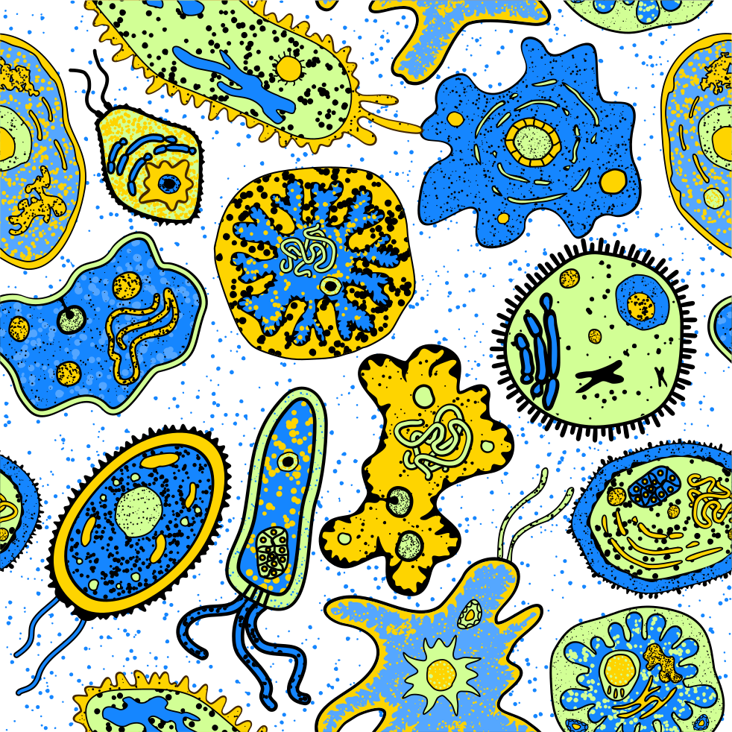

Understanding Antimicrobial Resistance

Slide 4
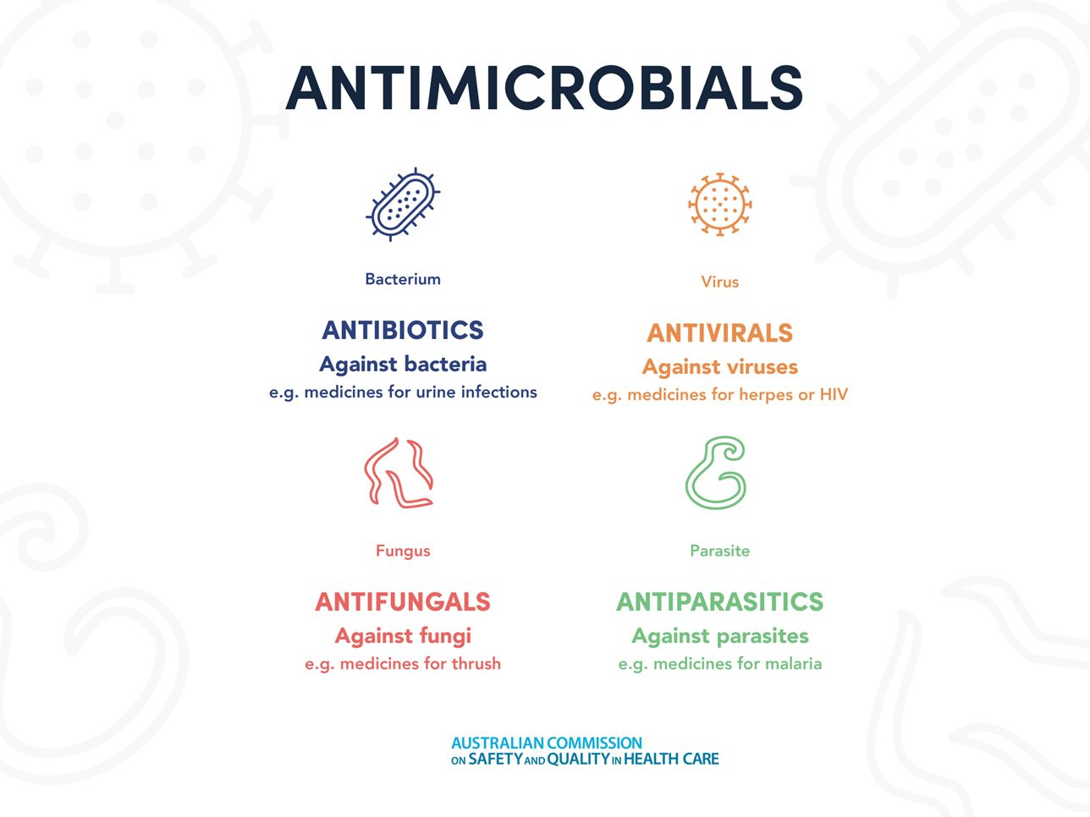
Antimicrobials
A substance that kills microorganisms such as bacteria or fungi, or stops them from growing and causing disease.

Slide 5
Antimicrobial Resistance
Antimicrobial resistance (AMR) occurs when bacteria, parasites, viruses or fungi change/evolve to protect themselves from the effects of antimicrobial drugs designed to destroy them.
This means previously effective antimicrobial drugs used to treat or prevent infections may no longer work.
The World Health Organization (WHO) has identified AMR as ‘one of the biggest threats to global health’.

Slide 6
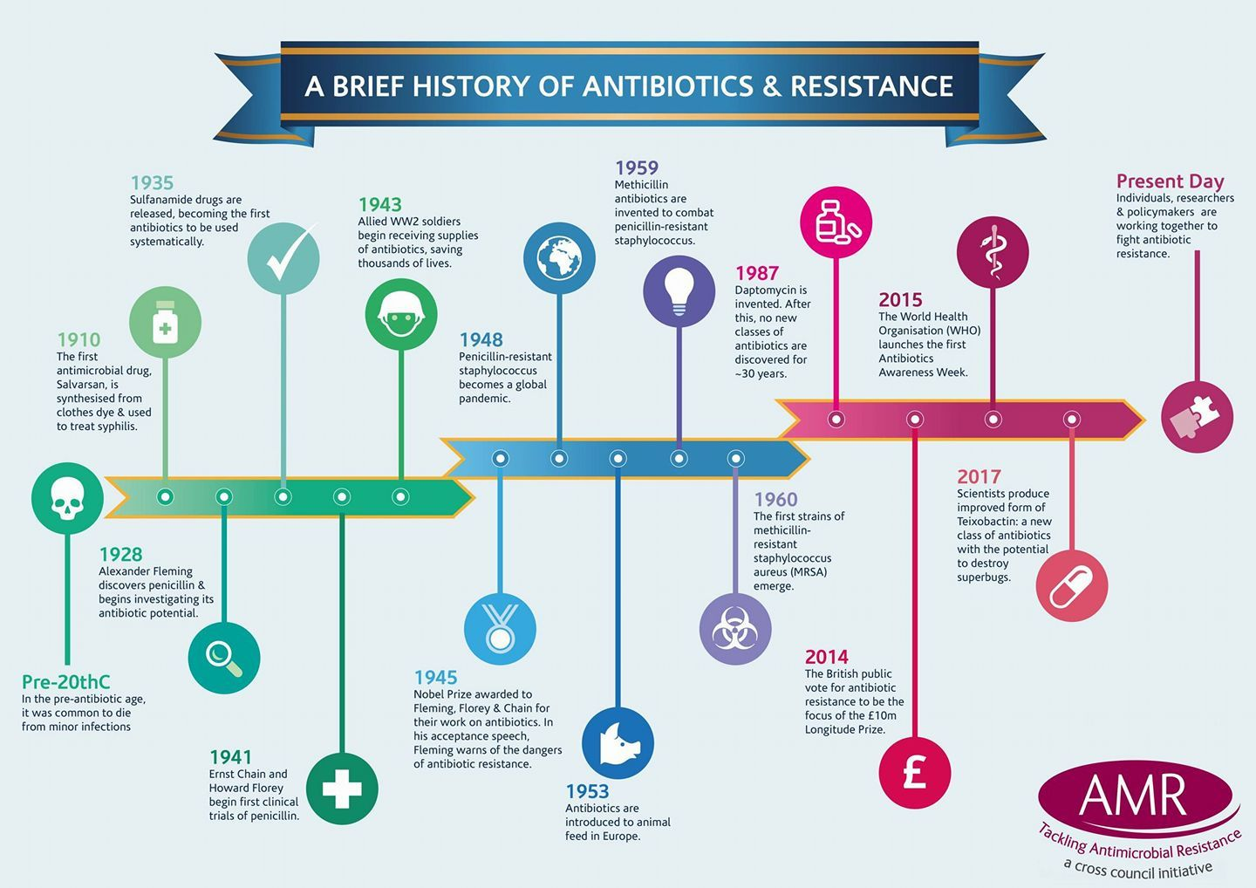

Slide 7
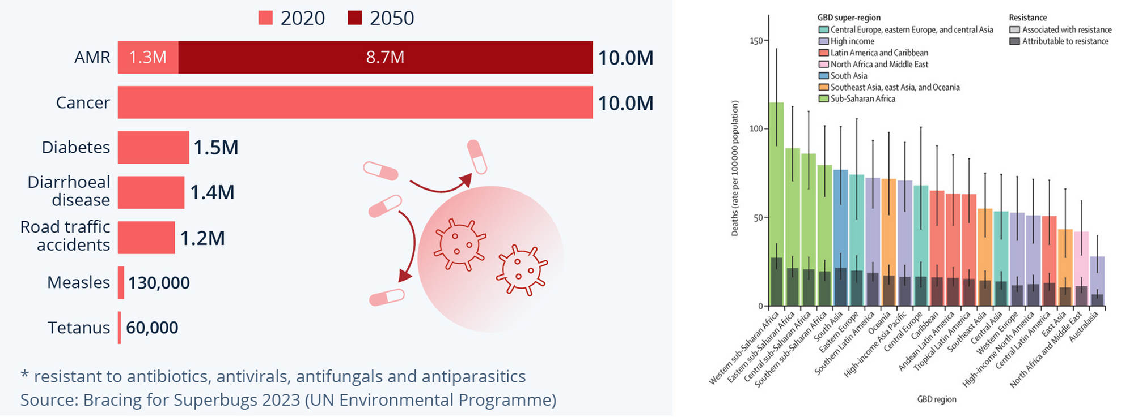
Deaths attributed to & associated with
bacterial AMR
Source: Global burden of bacterial antimicrobial resistance in 2019

Slide 8
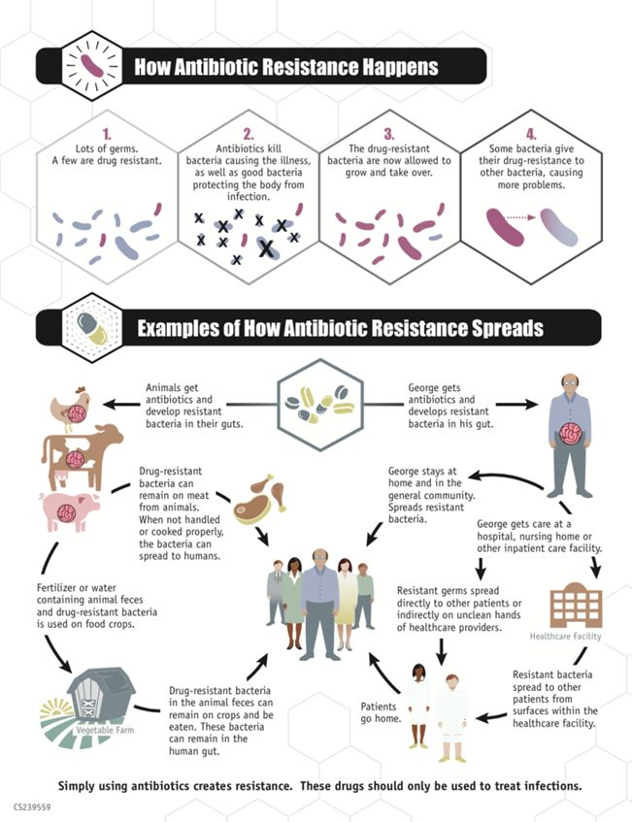

How Antimicrobial Resistance develops

Slide 9
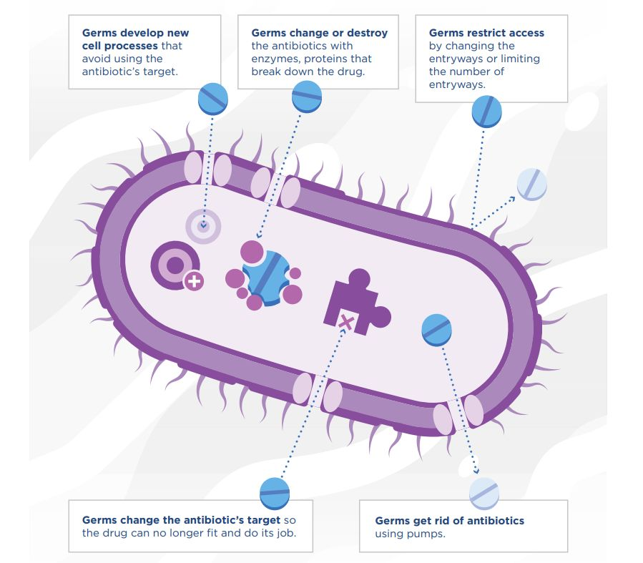
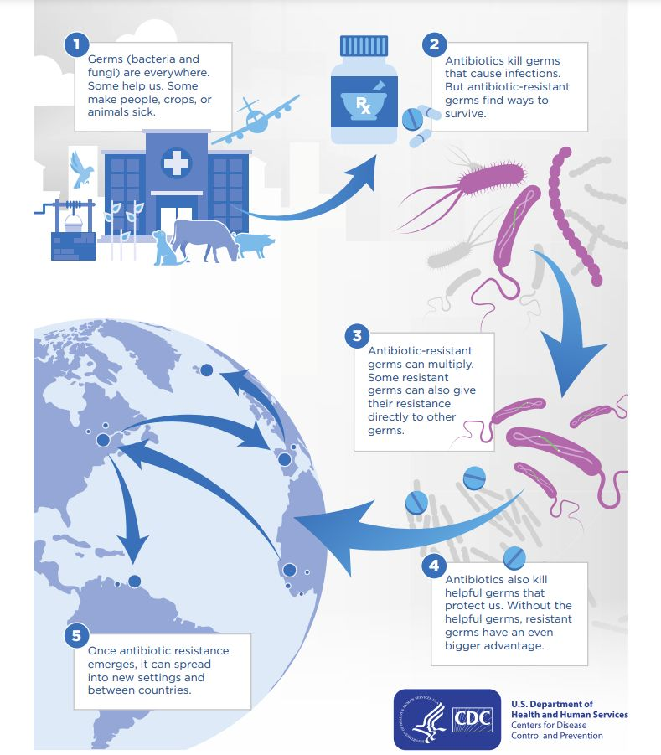

Slide 10
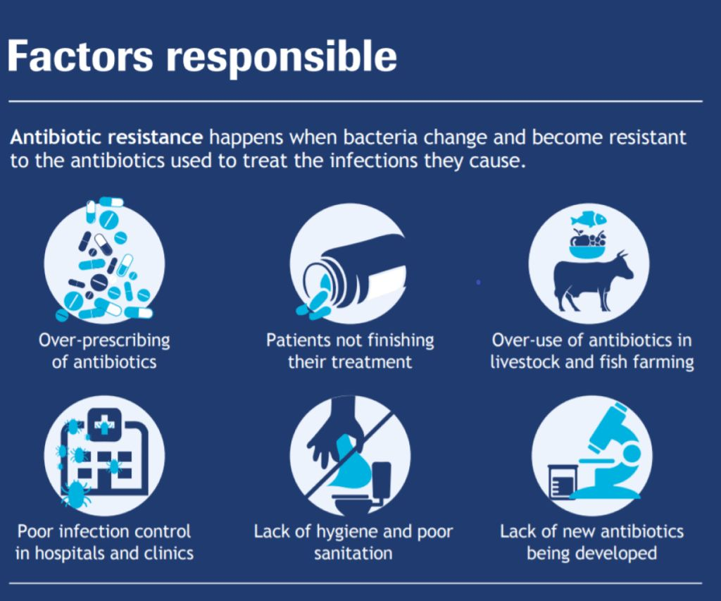

Slide 11
Infection, Prevention & Control

Slide 12

Infection Prevention & Control
Essential for the well-being and safety of patients, their families, healthcare workers, and the community.
Prevention of HAIs reduces the need for antimicrobials, contributing to mitigating the burden of AMR in health care.
A well-organized IPC programme is a basic requirement in every Health care Facility (HCF) to assist HCWs in the provision of quality healthcare.
Source: Dr. Umabala Pamidimukkala

Slide 13
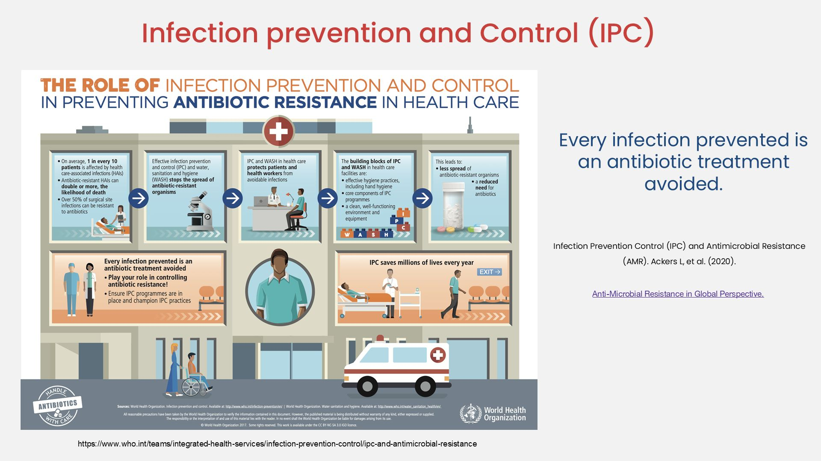
Source: Dr. Karishma Kaushik

Slide 14

Chain of Transmission
Causative Agent
Susceptible Host
Reservoir
Portal of Entry
Portal of Exit
Mode of Transmission
Source: Dr. Umabala Pamidimukkala

Slide 15
Standard Precautions
A group of infection prevention practices that apply to all patients, regardless of suspected or confirmed infection status, in any setting in which healthcare is delivered
applies to blood, body fluids, all secretions, excretions except sweat, non-intact skin, and mucous membranes which may contain transmissible infectious agents.
Source: Dr. Umabala Pamidimukkala

Slide 16

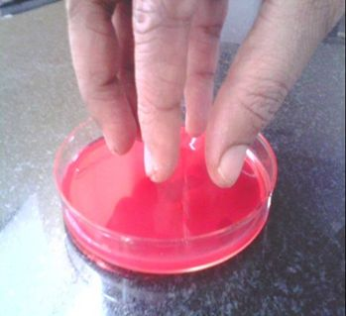
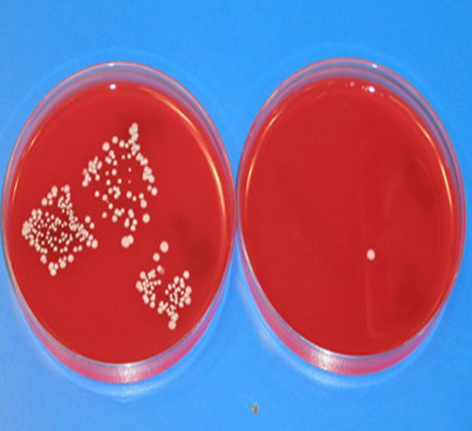

1. Hand Hygiene
Single most effective method of reducing the spread of infection
Hand Hygiene Culture test Before Hand Hygiene After Hand Hygiene
Source: Dr. Umabala Pamidimukkala

Slide 17
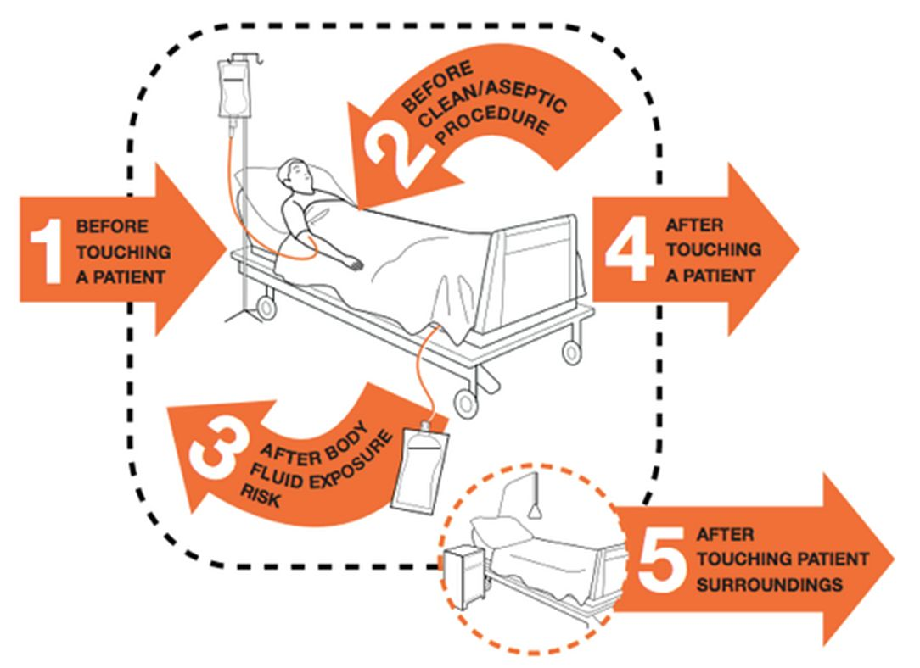
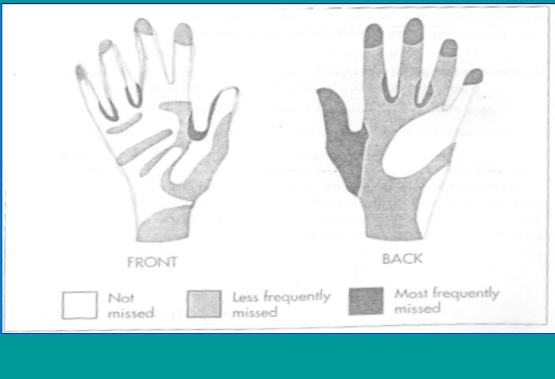
Moments of Hand Hygiene
AREAS OF THE HAND FREQUENTLY MISSED WITH POOR HAND WASHING
Source: Dr. Umabala Pamidimukkala

Slide 18
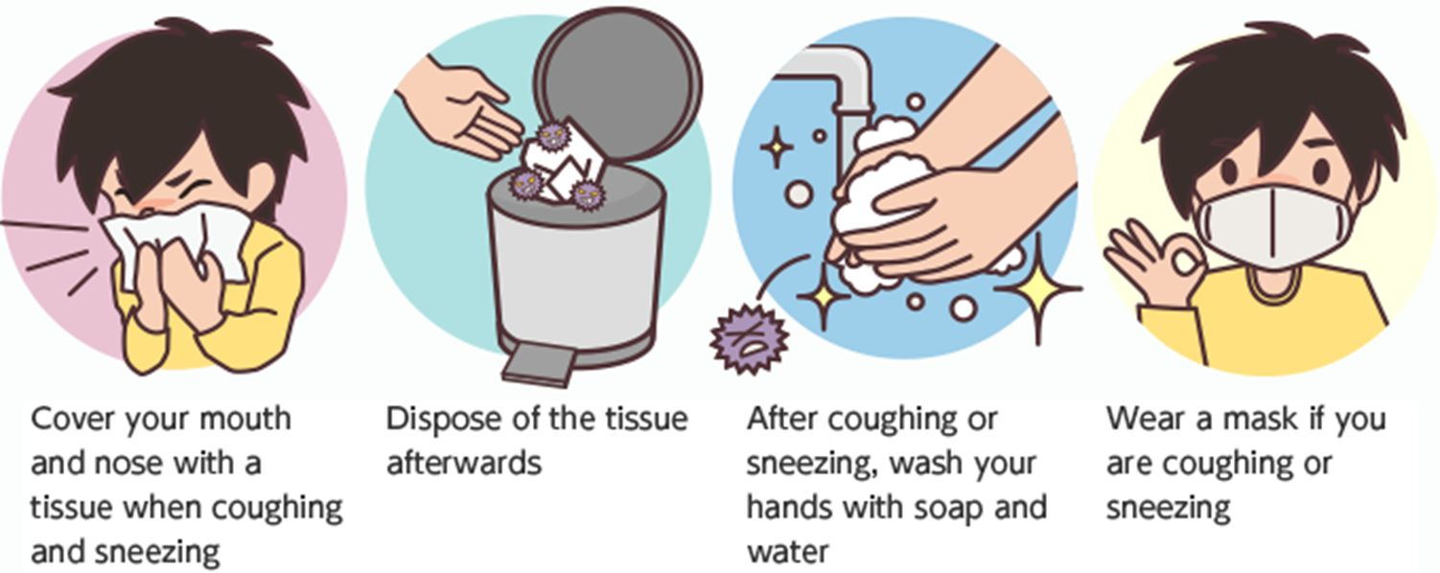
2. Respiratory Hygiene
Spatial separation of 3 feet (minimum)
Source: Dr. Umabala Pamidimukkala

Slide 19

3. Injection Safety
The primary breaches are
Reinsertion of used needles into a multiple-dose vial or solution container (e.g. saline bag)
Use of a single needle/syringe to administer intravenous medication to multiple patients.
NEVER administer medications from the same
syringe to more than one patient even if the needle
is changed.
Source: Dr. Umabala Pamidimukkala

Slide 20
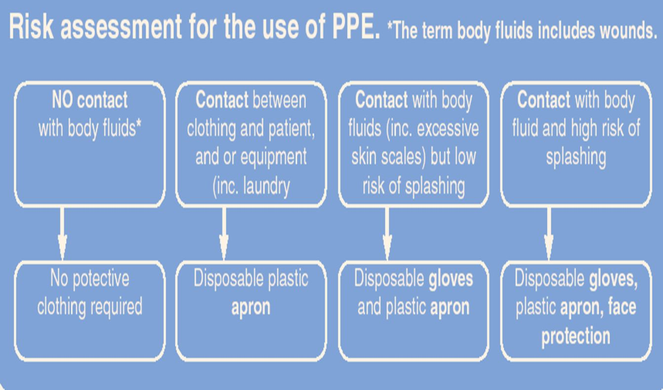

4. Personal Protective Equipment (PPE)
Gloves
Aprons
Face Masks
Goggles/eye protection
Full body suits
Over shoes
Hat/hoods
Risk Assessment for the use of PPE
Source: Dr. Umabala Pamidimukkala

Slide 21
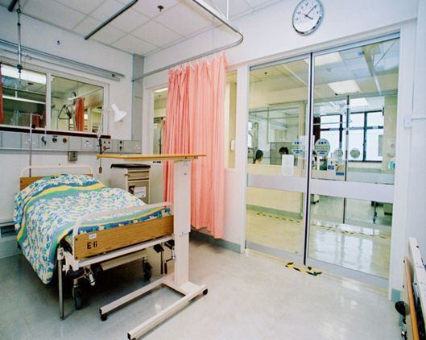
5. Patient Placement
Risk assessment for all patients
Consideration: availability of isolation facilities & positive/negative pressure rooms
Priority:
Pathogenicity of the infectious agent
Susceptibility of other patients
Needs and abilities of individual patients
Care setting involved
Source: Dr. Umabala Pamidimukkala

Slide 22


6. Environmental Disinfection
Clean and disinfect non-critical surfaces in patient-care areas are part of SP
Clean and disinfect all frequently touched surfaces in patient-care areas
EPA-registered disinfectants or detergents
Source: Dr. Umabala Pamidimukkala

Slide 23



7. Instrument/device Disinfection
Cleaning
Sterilization or Disinfection of medical instruments/devices
Source: Dr. Umabala Pamidimukkala

Slide 24
Antimicrobial Stewardship
Rational, Systematic approach to the use of antimicrobial agents to achieve optimal outcomes.
It is primarily to:
Optimise antimicrobial use
Reduce the emergence of antibiotic resistance
Improve patient outcomes
Provide cost effective therapy
Source: Dr. Umabala Pamidimukkala

Slide 25
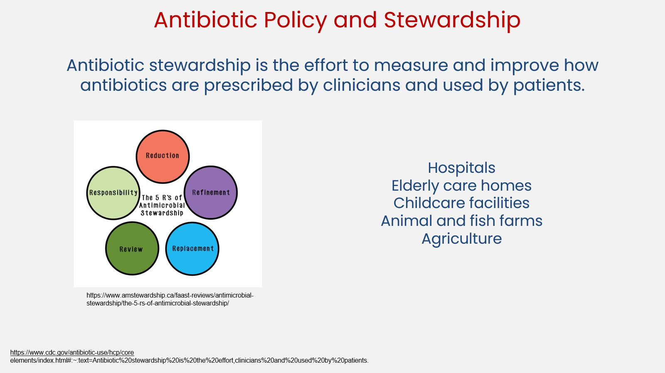

Slide 26
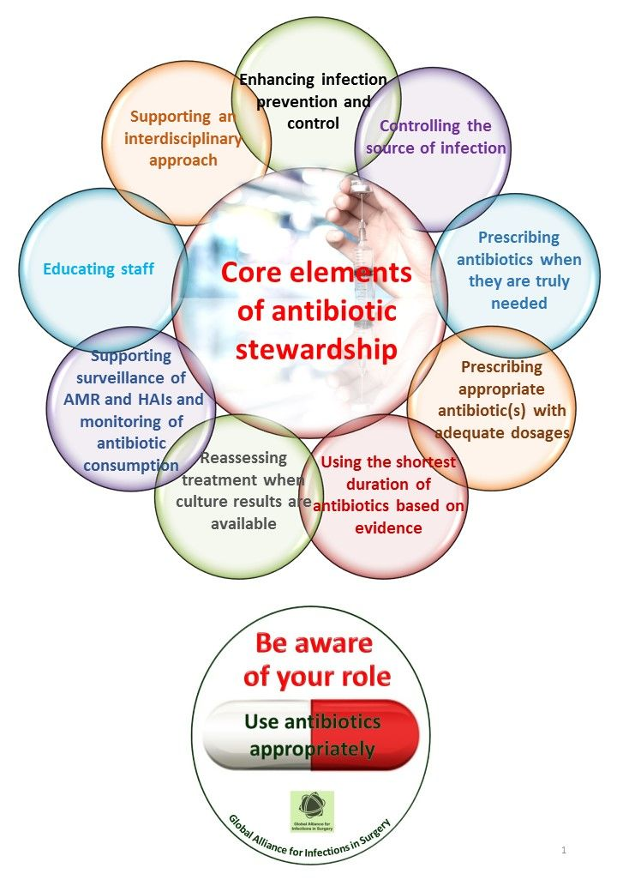
Source: Global Alliance for Infections in Surgery

Slide 27
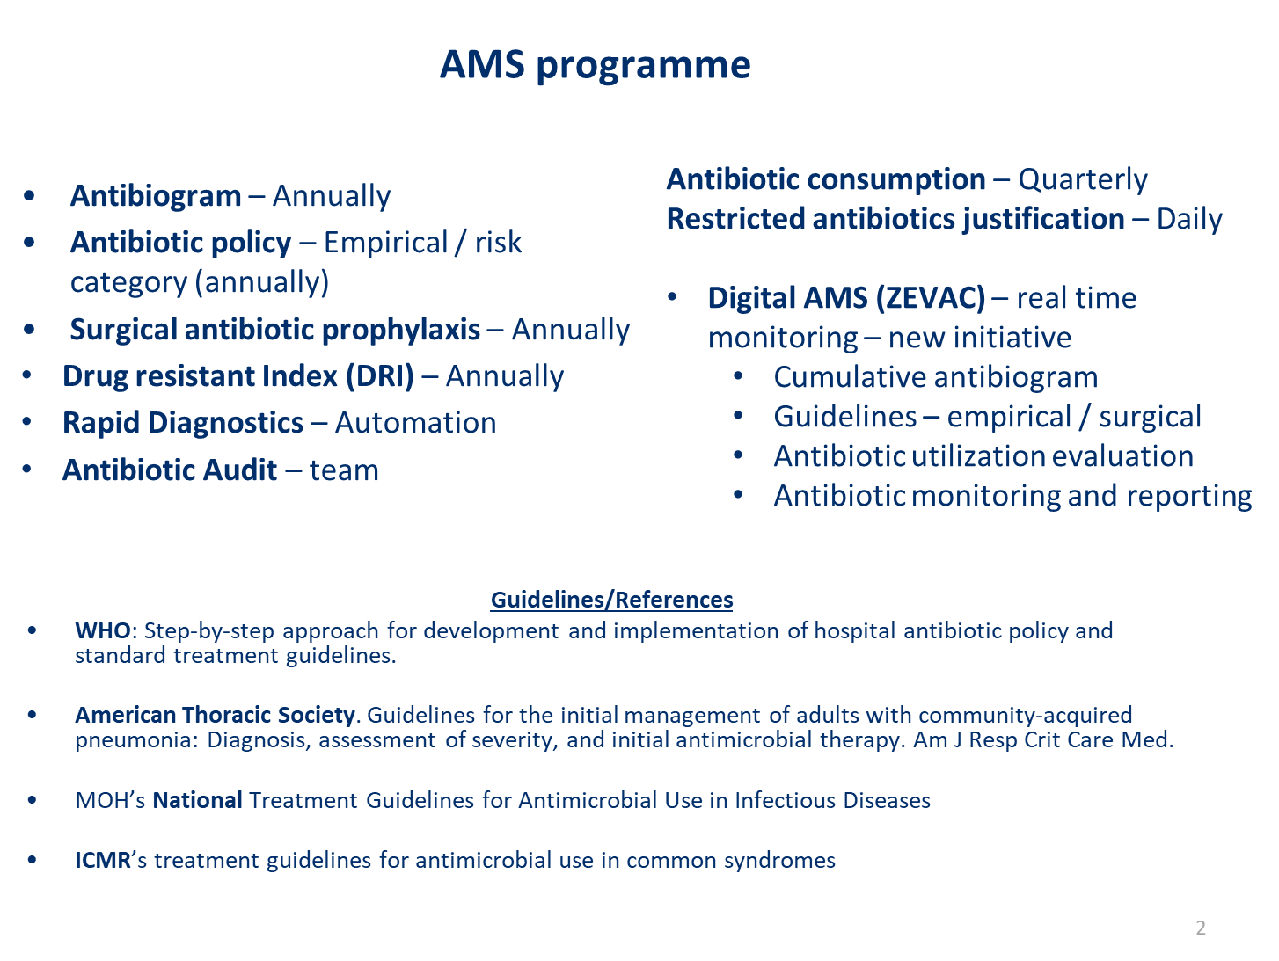
Source: Dr. Bansidhar Tarai

Slide 28
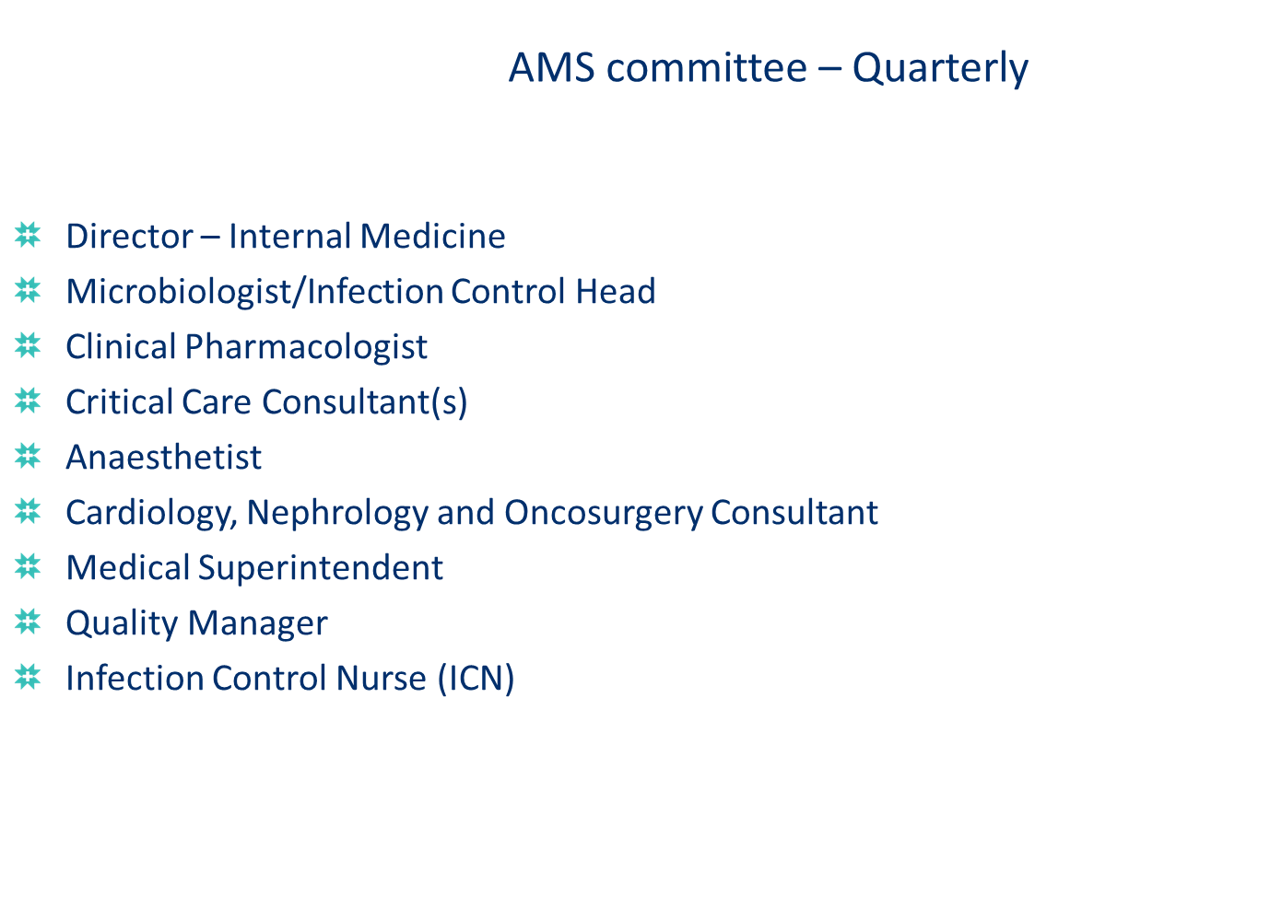
Source: Dr. Bansidhar Tarai

Slide 29
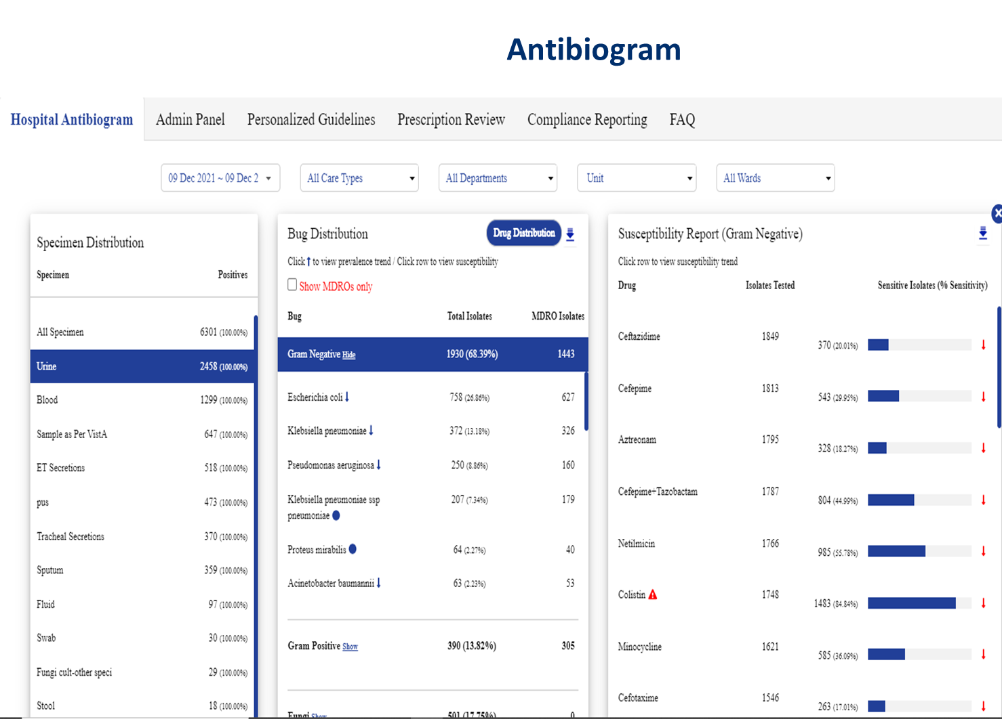
Source: Dr. Bansidhar Tarai
Notes:
An antibiogram is a summary report that shows how susceptible different bacterial strains are to various antibiotics in a specific setting, such as a hospital, region, or community, over a defined period. It’s based on laboratory testing of bacterial isolates from patient samples. Helps guide doctors in selecting effective antibiotics for treatment. Supports infection control and antimicrobial stewardship efforts. Typically updated annually by microbiology labs. In short, an antibiogram helps track local resistance patterns and informs better antibiotic use.

Slide 30
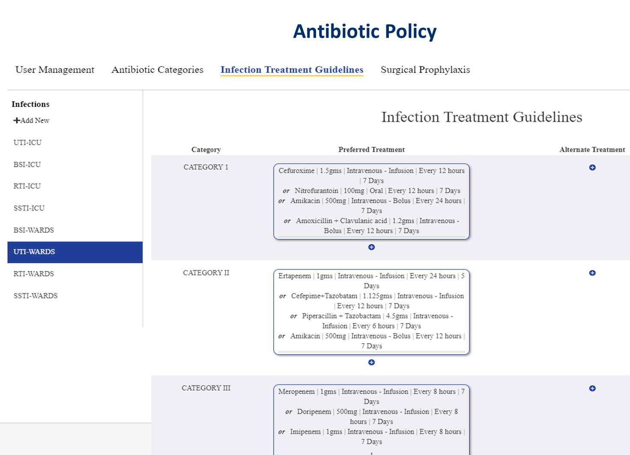
Source: Dr. Bansidhar Tarai
Notes:
An antibiotic policy is a guideline to ensure the appropriate use of antibiotics in healthcare settings. It helps standardize treatment, reduce misuse, and combat antimicrobial resistance. Policies are based on local resistance patterns and include recommended antibiotics, dosages, and restrictions on certain drugs.

Slide 31
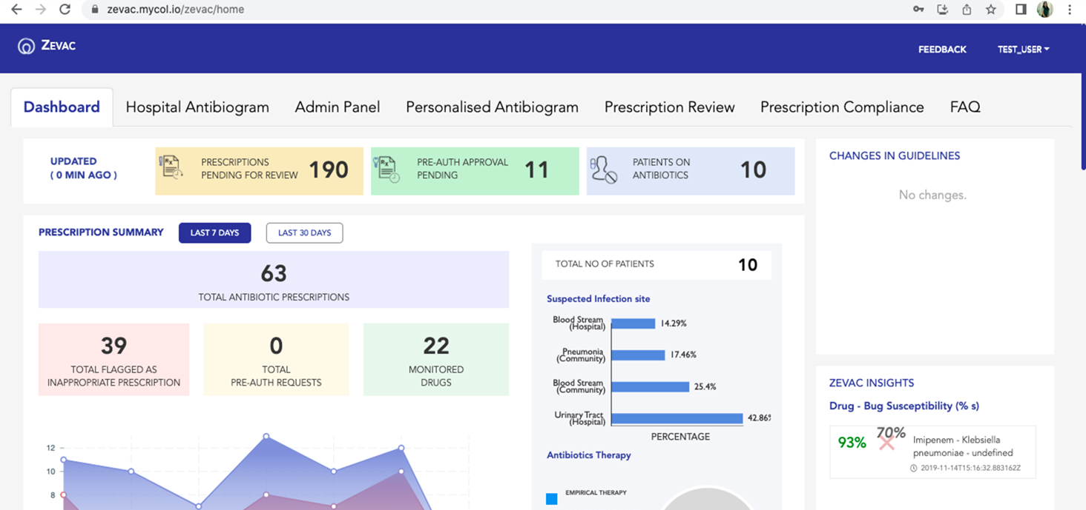
Source: Dr. Bansidhar Tarai
Notes:
The ZEVAC antimicrobial stewardship (AMS) software (in use at Max HealthCare) is an AI-driven tool that helps optimize antibiotic use in hospitals that tracks real-time antibiograms, monitors resistance trends, recommends antibiotics based on local data, and supports guideline creation and reporting.

Slide 32
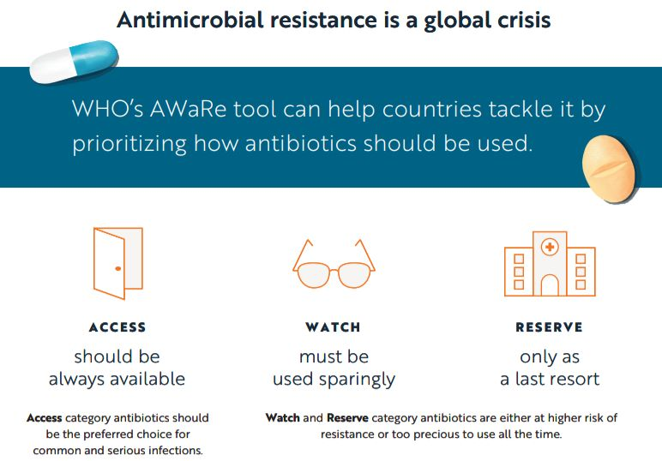
Source: WHO

Slide 33
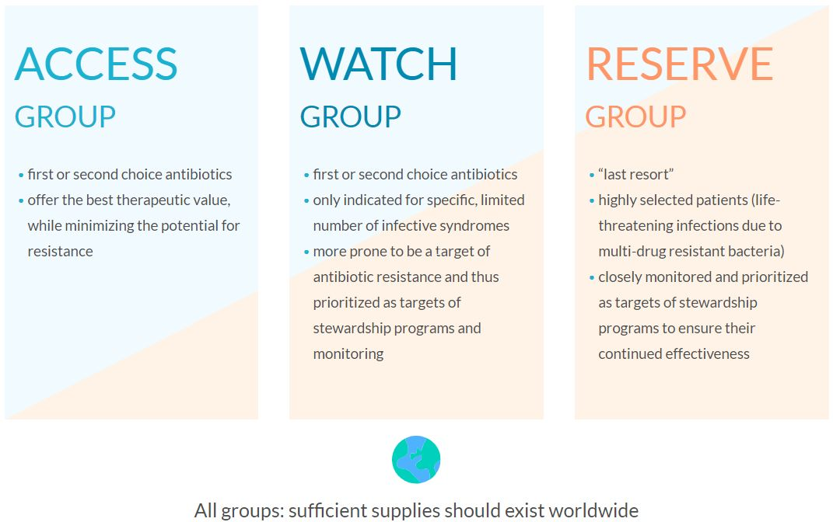
Source: WHO

Slide 34
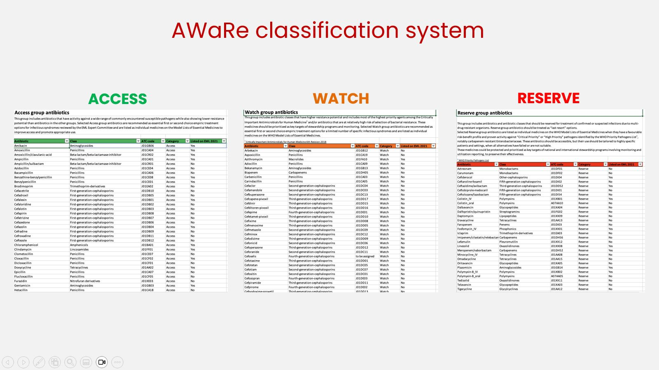

Slide 35
Diagnostic Stewardship
Interventions to modify the ordering, processing, and reporting of diagnostic tests in order to provide
the right test
for the right patient,
prompting the right action.
Source: Dr. Umabala Pamidimukkala

Slide 36
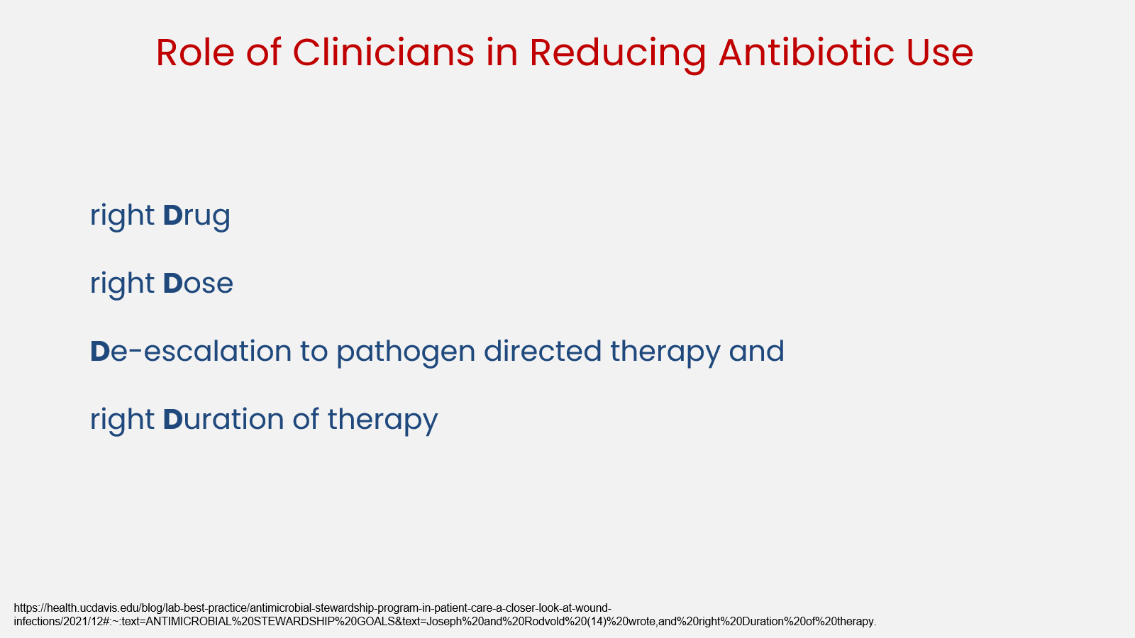

Slide 37
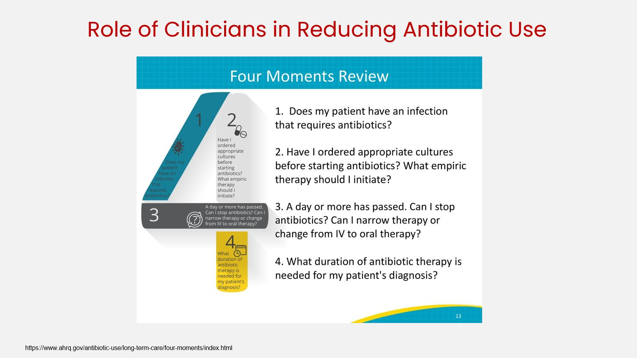

Slide 38
AMR Surveillance
systematic process of data collection, analysis, and reporting that quantitatively monitors spatial and temporal trends in the occurrence and distribution of susceptibility and resistance to antimicrobial agents.
an essential tool to inform policies and infection prevention and control responses.
the cornerstone for assessing the spread of AMR and to inform and monitor the impact of local, national and global strategies.
Source: Dr. Umabala Pamidimukkala

Slide 39
Clinical Surveillance
Process and share the AMR surveillance results of routinely collected clinical samples.
AST of the priority microorganisms responsible for infections.
timely confirmatory testing, including phenotypic (culture) and genotypic characterization (PCR, genomic sequencing).
Clinical Surveillance Networks in India:
ICMR - AMR surveillance and research network (AMRSN)
NCDC - National Antimicrobial Surveillance network (NARS-Net)
WHO - Indian Network for Surveillance of Antimicrobial Resistance (INSAR)
Source: PAHO

Slide 40
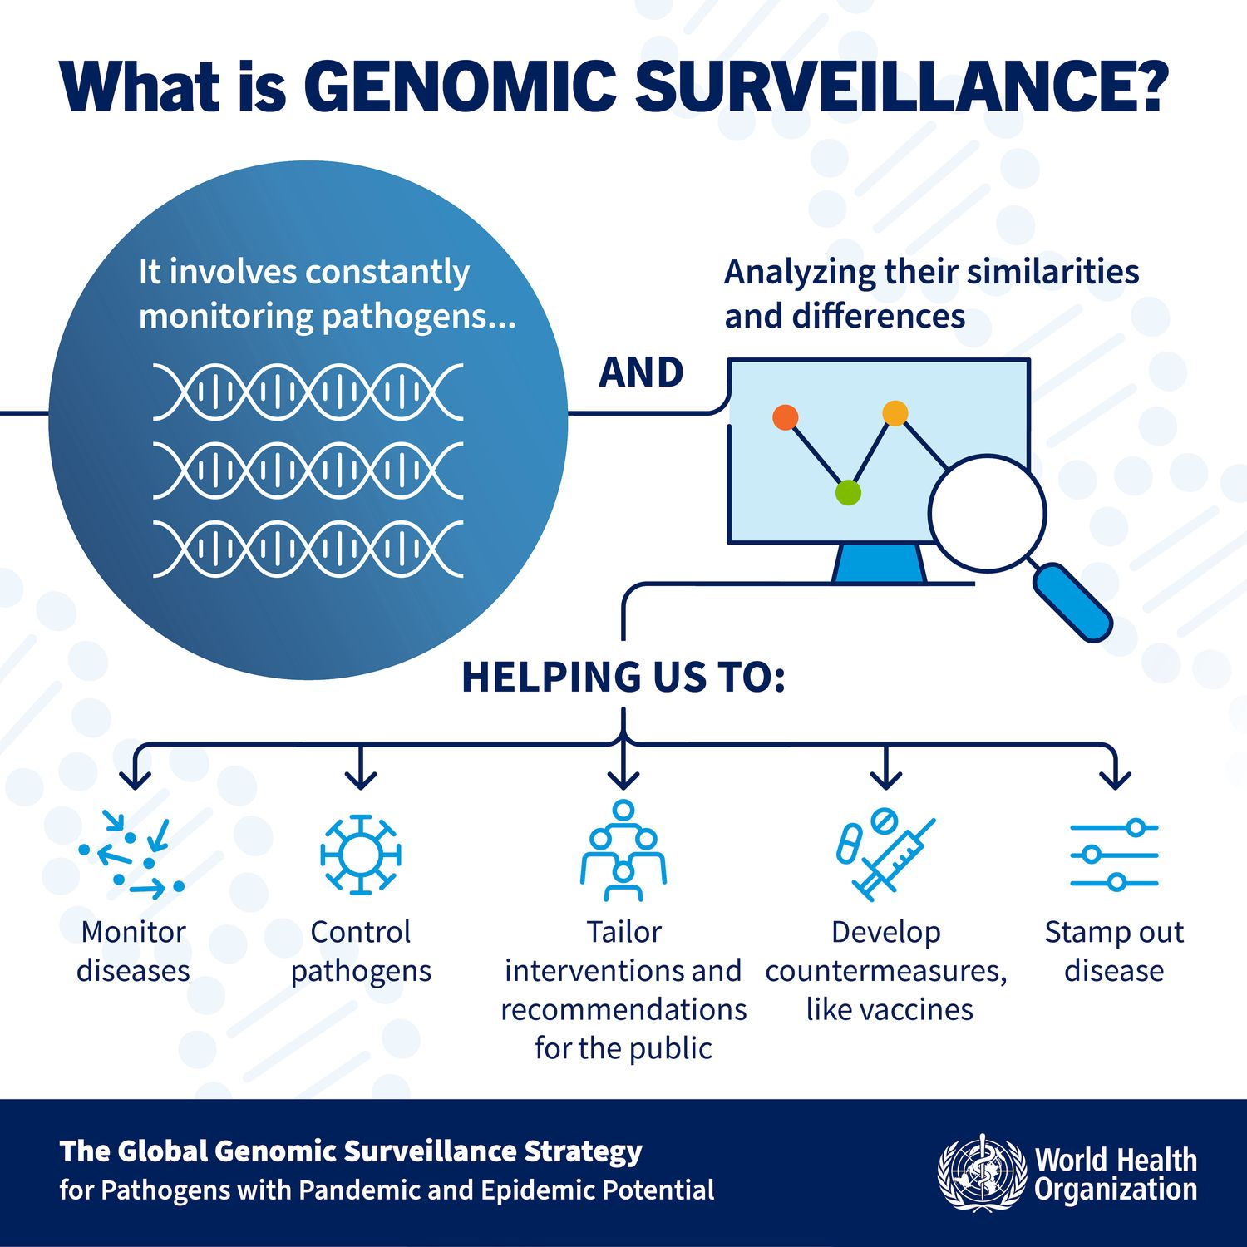

Genomic Surveillance
Source: WHO

Slide 41
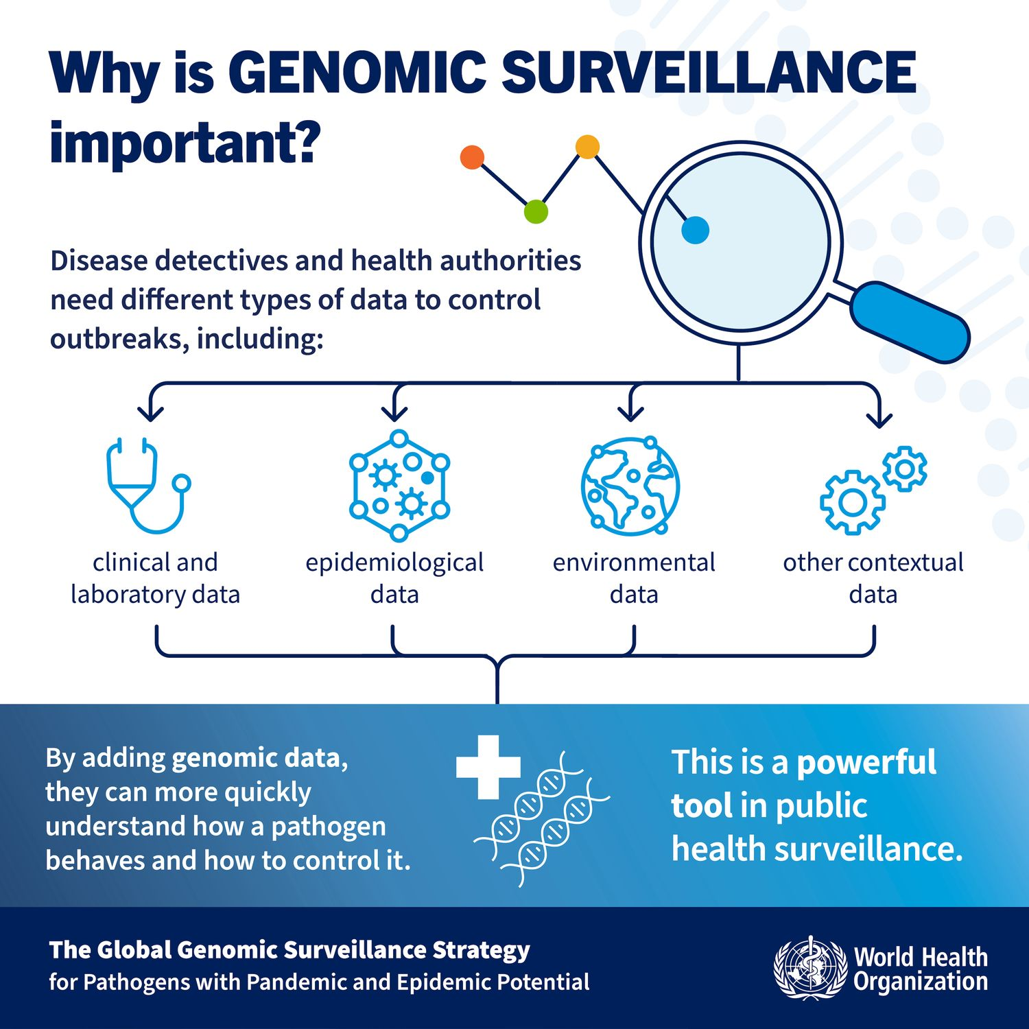
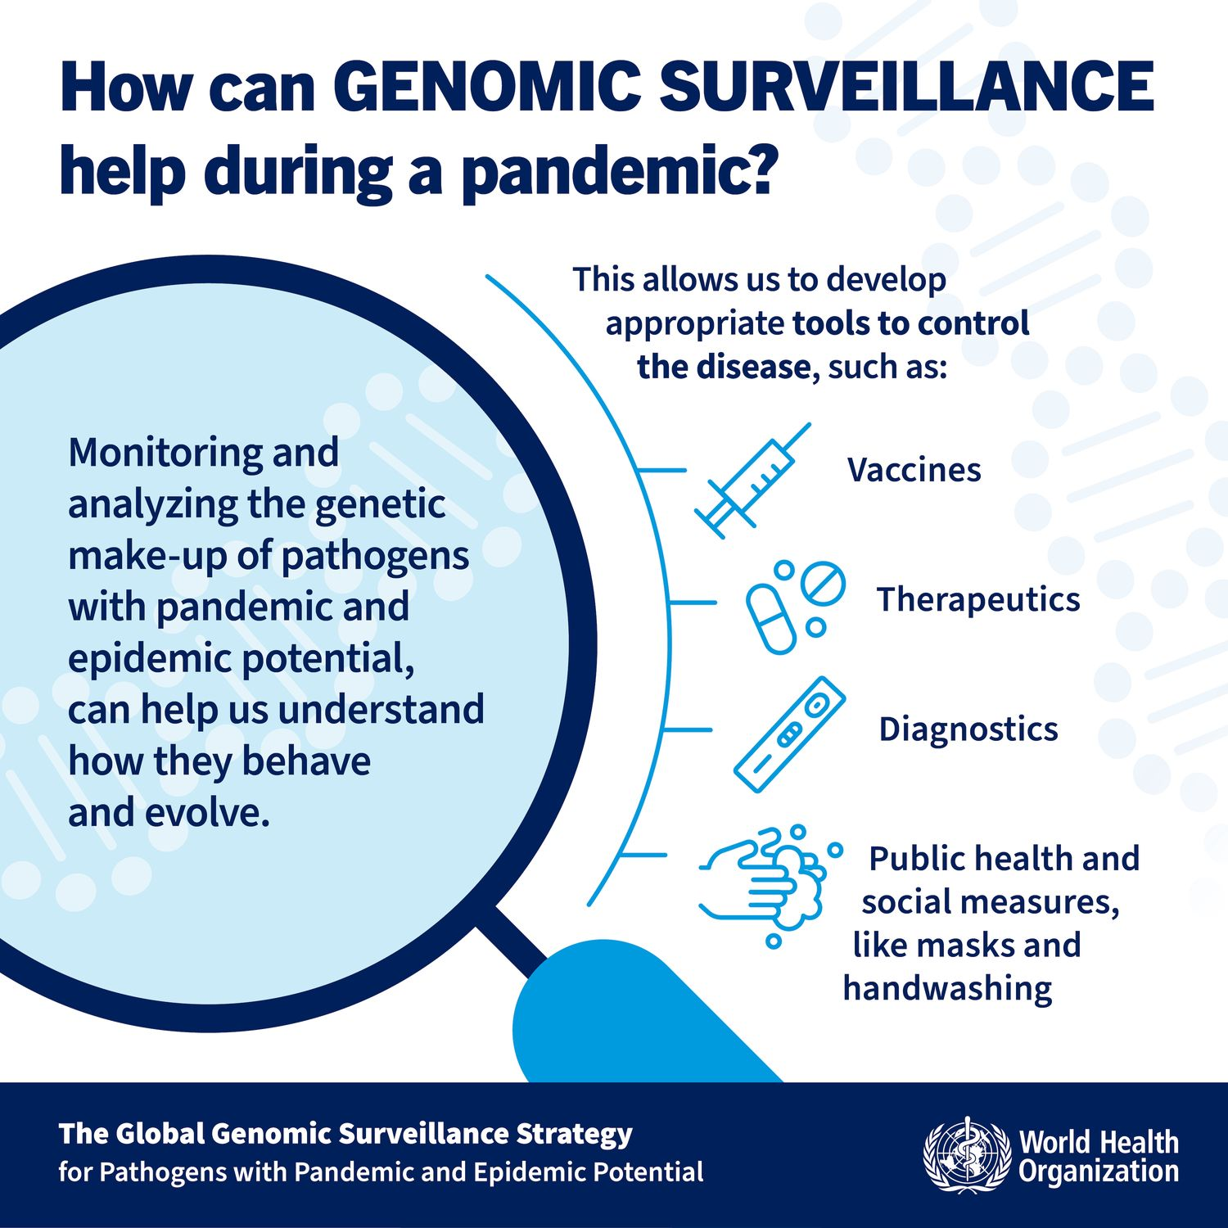
Source: WHO

Slide 42
Environmental Surveillance
The environment and the AMR pandemic are strictly linked.
The environment is both a vehicle for spreading AMR microbes and a culprit of antimicrobial pollutants, which negatively impact biodiversity and ecosystems (UNEP, 2022).
It operates on the “One Health” Approach, an integrated, unifying approach that aims to sustainably balance and optimize the health of humans, animals, plants and ecosystems.
Source: Geneva Environment Network

Slide 43

One Health Approach
Source: CDC

Slide 44
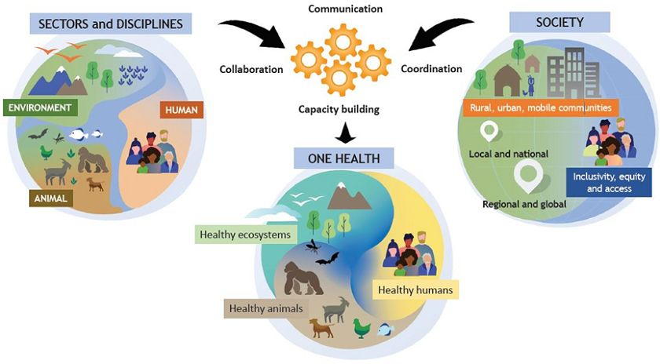
One Health toward a sustainable healthy future
Source: One Health High-Level Expert Panel (OHHLEP)

Slide 45
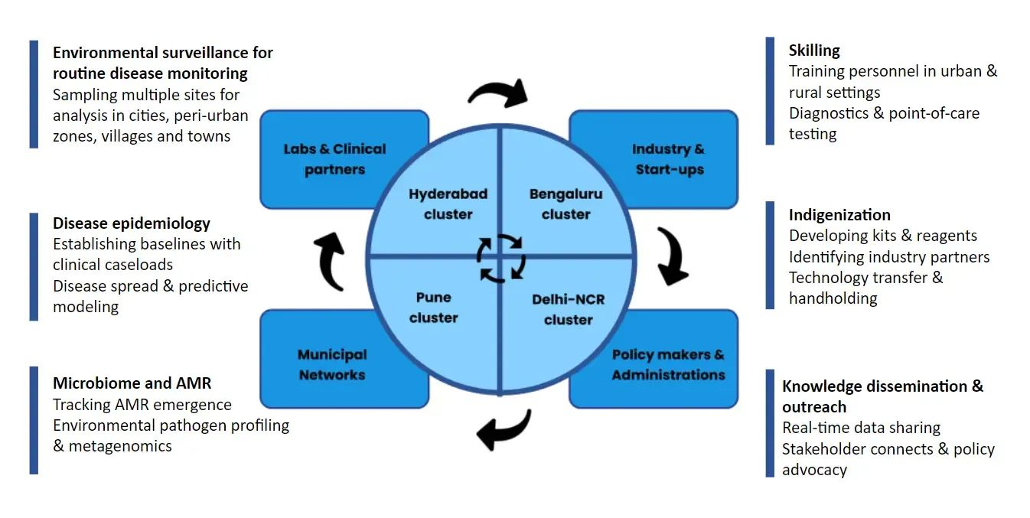
Alliance for Pathogen Surveillance Innovation (APSI) – India
Source: APSI
Notes:
The Alliance for Pathogen Surveillance Innovation (APSI) – India was established in 2021 to strengthen pathogen surveillance across the country. APSI focuses on developing advanced, affordable technologies using genome sequencing, wastewater-based detection, and bioinformatics to monitor pathogens of public health concern. These tools are applied to both clinical and environmental samples. In the wake of COVID-19, wastewater-based epidemiology has emerged as a key early warning system. APSI envisions city-wide, data-driven surveillance as critical to preventing future pandemics and supporting stronger public health systems.
More Information on APSI: https://data.ccmb.res.in/apsi/

Slide 46

APSI’s Vision for Environmental Surveillance
1
3
5
Integrating wastewater surveillance into state-level health protocols for early disease detection.
Pathogen detection and clinical correlation for comprehensive health insights.
Developing cost-effective, reliable surveillance kits for widespread use.
2
4
Partnering with industry and clinical bodies for advanced tool creation and validation.
Utilizing surveillance data for informed policy making and effective local disease management.
Source: APSI

Slide 47
Challenges related to AMR
Poor IPC practices and Poor applicability of AMSP programs in healthcare facilities
Lack of Local and National surveillance systems for generating AMR data
Limited access to diagnostics
Lack of Personnel, equipment and resources
Source: Dr. Umabala Pamidimukkala

Slide 48
Challenges related to AMR
Poor management of sanitation and waste
Low level of awareness about antimicrobials, Self medication, Over the counter availability
Lack of leadership and governance from health Policy makers
Lack of regulations on the use of antimicrobials in animals and agriculture
Source: Dr. Umabala Pamidimukkala

Slide 49
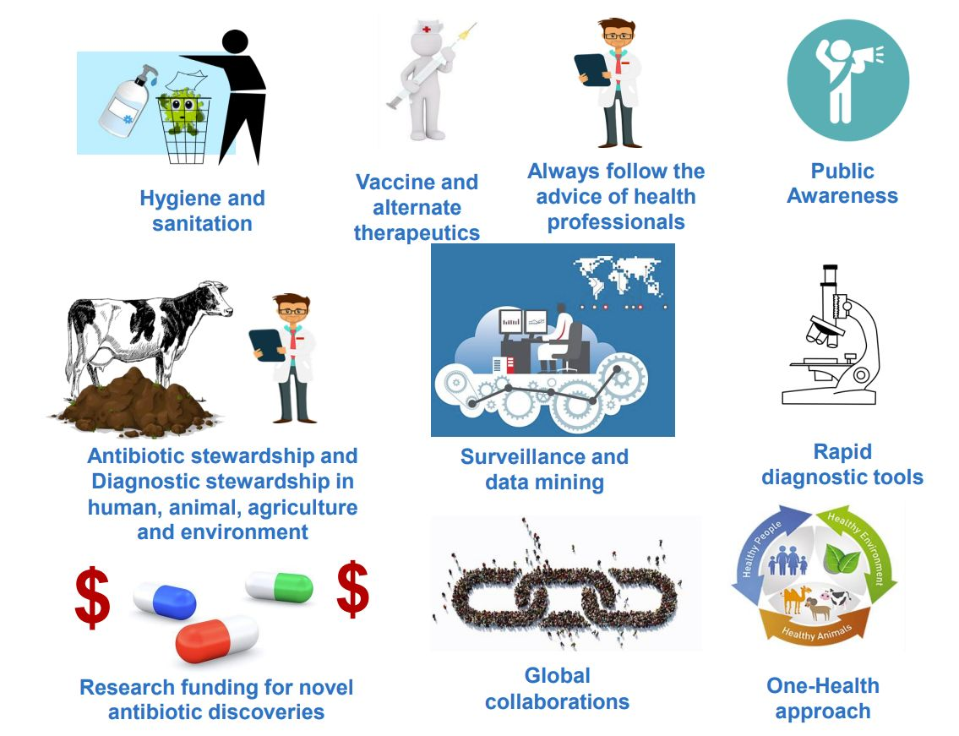
Steps
to tackle AMR - Global Measures

Slide 50
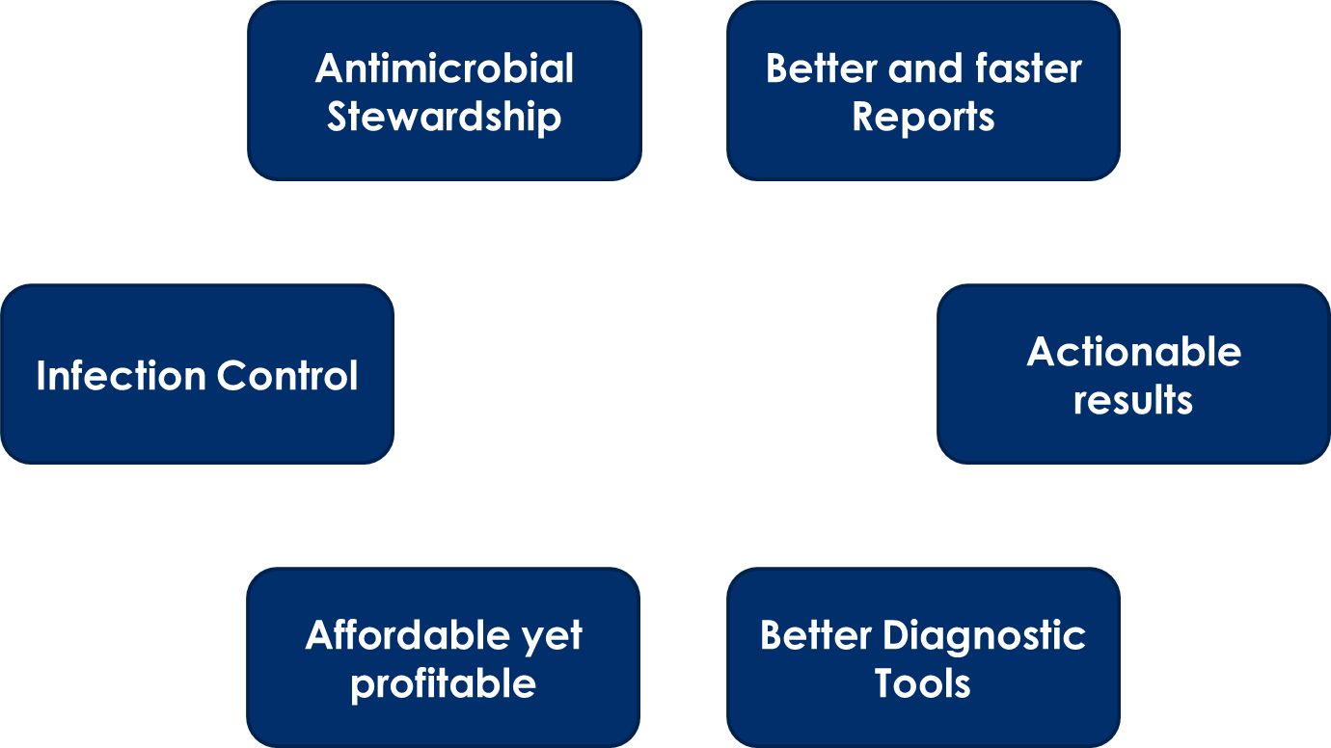
What Healthcare
Facilities need
Source: Dr. Bansidhar Tarai

Slide 51
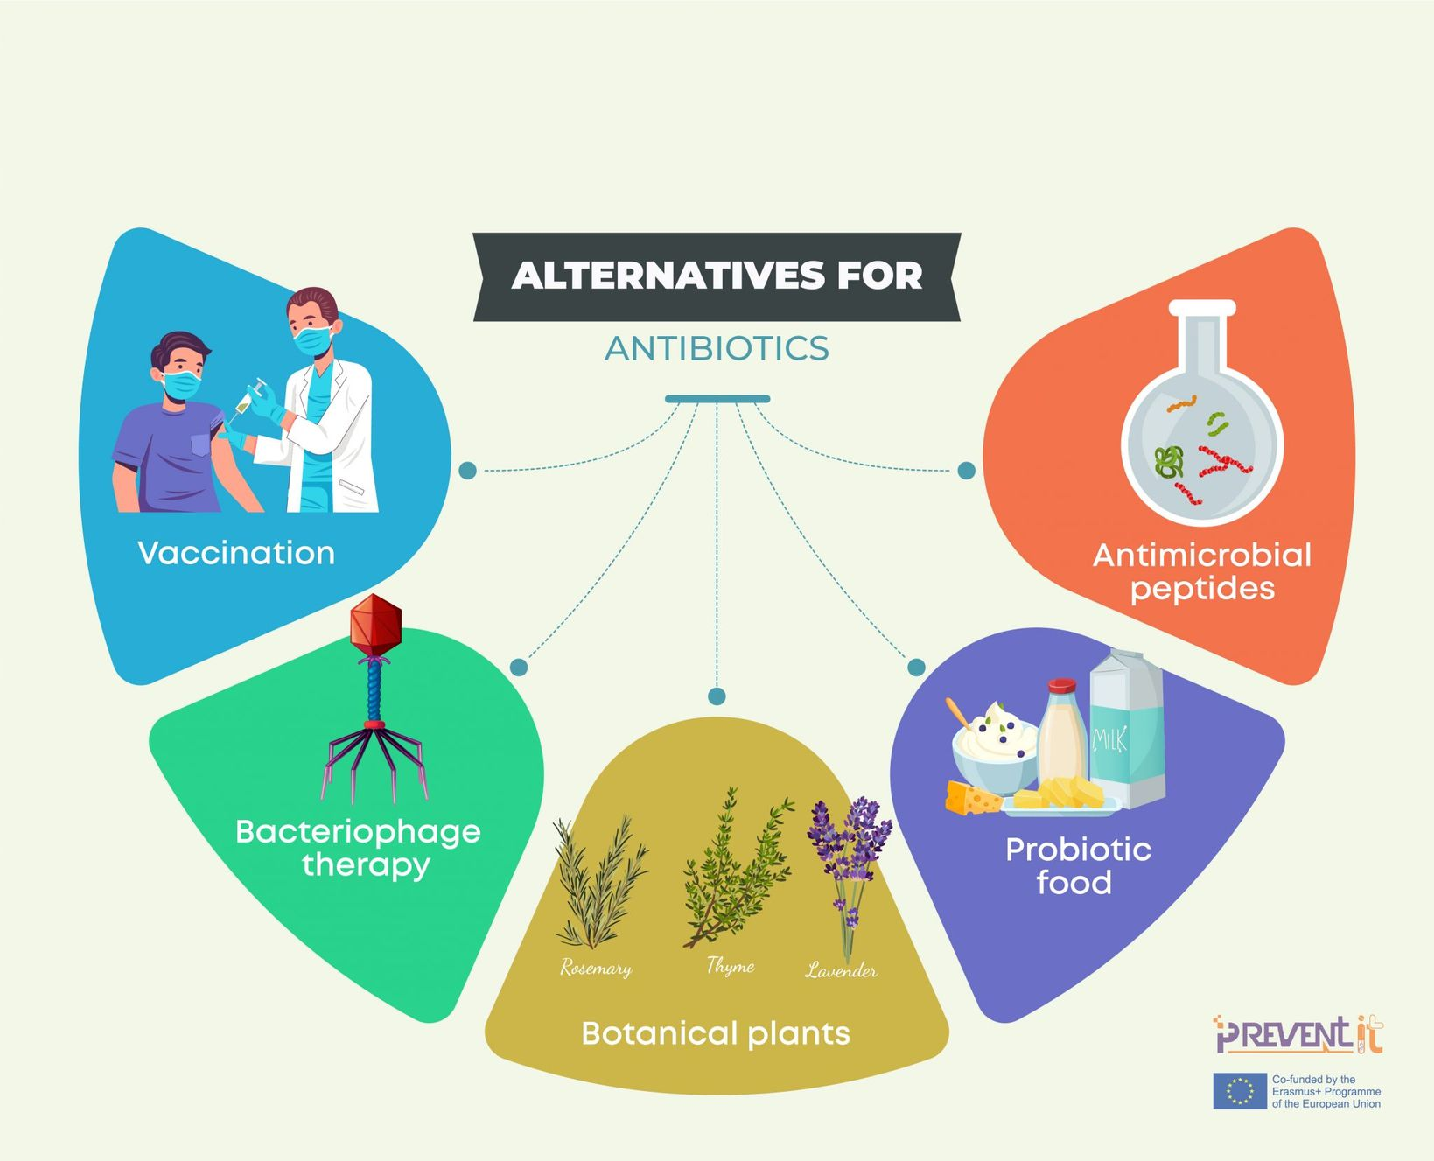

Slide 52
Steps to tackle AMR
Medical Students and Healthcare Professionals:
Improved infection prevention and control practices
Responsible antibiotic prescribing and dispensing
Encourage vaccination and increase AMR awareness
Hospital Administration:
Develop strategies for effective IPC
Enhance AMR Surveillance to accurately assess and monitor the spread of AMR
Increase diagnostics access (Diagnostic Stewardship)
Implement robust AMR Stewardship programs to optimize antimicrobial use

Slide 53
Steps to tackle AMR
Government and Policymakers
Improve regulations on antimicrobial use and safe disposal of antibiotics
Implement AMR Surveillance Network for disease epidemiology and prediction Ensure R & D for new diagnostic tools and treatment regimens to combat AMR
Education and awareness programs on AMR for different stakeholders
Access to Vaccines
“Collaborate with stakeholders across sectors to create a unified and coordinated response to the AMR threat.”

Slide 54
Educational Resources
WHO Course:
Antimicrobial Resistance: https://openwho.org/channels/amr
Infection Prevention and Control: https://openwho.org/channels/ipc
Antimicrobial Stewardship: https://openwho.org/courses/AMR-competency
Coursera Course:
Antimicrobial Resistance: https://www.coursera.org/learn/antimicrobial-resistance
CDC Course:
Antibiotic Stewardship: https://www.train.org/cdctrain/training_plan/3697

Slide 55
Educational Resources
Stanford Online
Antibiotics Review: http://errolozdalga.com/medicine/pages/OtherPages/AntibioticReview.ChanuRhee.html
Antibiotics and Outpatient Infections (CME): https://online.stanford.edu/courses/som-ycme0020-prescribe-or-not-prescribe-antibiotics-and-outpatient-infections-cme
Fleming Fund Online AMR Course
Diagnostic Stewardship: https://www.open.edu/openlearncreate/course/view.php?id=6559
AMR Surveillance: https://www.open.edu/openlearncreate/course/view.php?id=6548

Slide 56
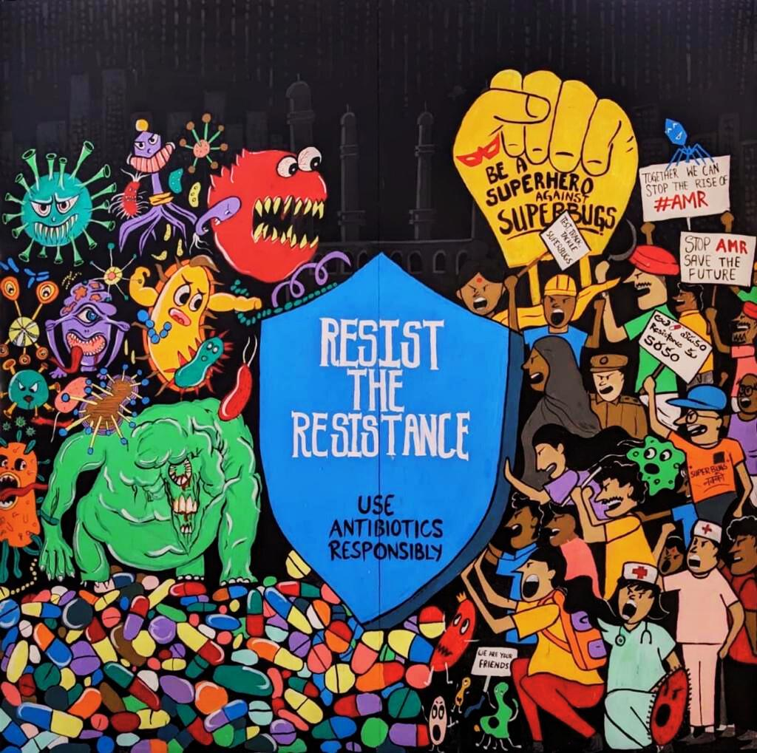


Unite with the Superheroes in the fight against Superbugs!
Scan to visit our website
Scan for our IG page

