Slide 1

AMR Frontline Workshops
AMR Awareness Workshop Format for Medical Students (2025)

Slide 2
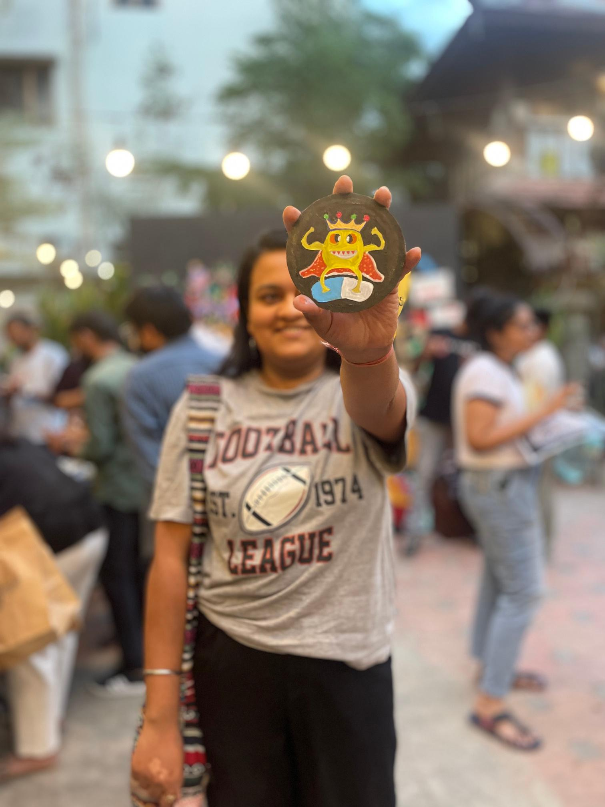
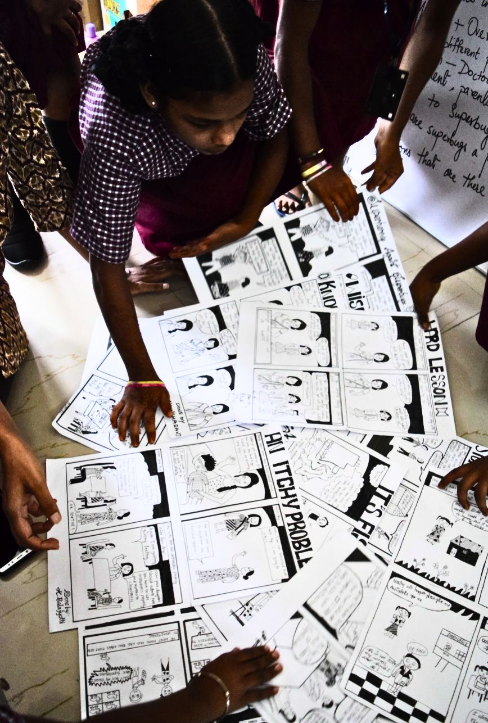
About SaS
Superheroes Against Superbugs (SaS) is an educational and public engagement initiative to raise awareness and promote public and policy action on Antimicrobial Resistance (AMR) in India.
Notes:
This slide deck and the workshop format is curated by Superheroes Against Superbugs, which is an educational and public engagement initiative that aims to raise awareness and catalyze both public and policy action on AMR in India. Since its inception in 2018, it has been empowering people to become informed advocates of AMR through interactive programs and collaborations.

Slide 3
General notes for the users of this template
Created by Superheroes Against Superbugs (SaS), this template provides a ready-to-use framework for a day-long interactive workshop with medical students, featuring suggested activities and expert talks. The workshop content and format are suitable for medical students from the 2nd year onwards, including postgraduates and interns. Each element of the workshop has been piloted and refined through multiple sessions, ensuring it is effective and impactful for participants. To maximise engagement and learning, keep the workshop dynamic and participatory. Each slide has notes for the workshop facilitator. Refer to the agenda and activities provided on the SaS website to understand the optimal use of this deck. To explore any of the workshop topics in more detail, please refer to the AMR slide deck available on our website.
The AMR Frontline Workshop series for medical students was launched in partnership with the Alliance for Pathogen Surveillance Innovations–India (APSI-India) and supported by the Rockefeller Foundation. Around 27 workshops were held across medical colleges nationwide, and this format is a general template curated from that series. Our sincere thanks to APSI-India for partnering with us to bring these workshops to medical colleges across the country. Our heartfelt thanks to the expert speakers and medical student volunteers who played a key role in shaping the workshops - co-creating activities, reviewing content, and adding valuable perspectives.This presentation is for non-commercial, educational purposes only. Please write to sasindia2018@gmail.com with any inputs/feedback.

Slide 4






Workshop at a glance
What is Antimicrobial Resistance (AMR)?
How bugs become resistant to antibiotics — a look at bacteria, antibiotics, and superbugs.
Expert Talks
Why has AMR become a public health challenge?
Key drivers of AMR and why it’s a growing threat to global health.
Learning through Case Studies
The role of healthcare providers in addressing AMR
How medical students and clinicians can promote responsible antibiotic use and community awareness.
Fun Games and
Group Activities
Notes:
Facilitator’s Note: This is an indicative agenda for a day-long workshop. Feel free to choose the themes, topics, and formats of your workshop based on the time and resources available, as well as your subject knowledge and skill sets. Tailor the sessions to best suit your audience and objectives.

Slide 5
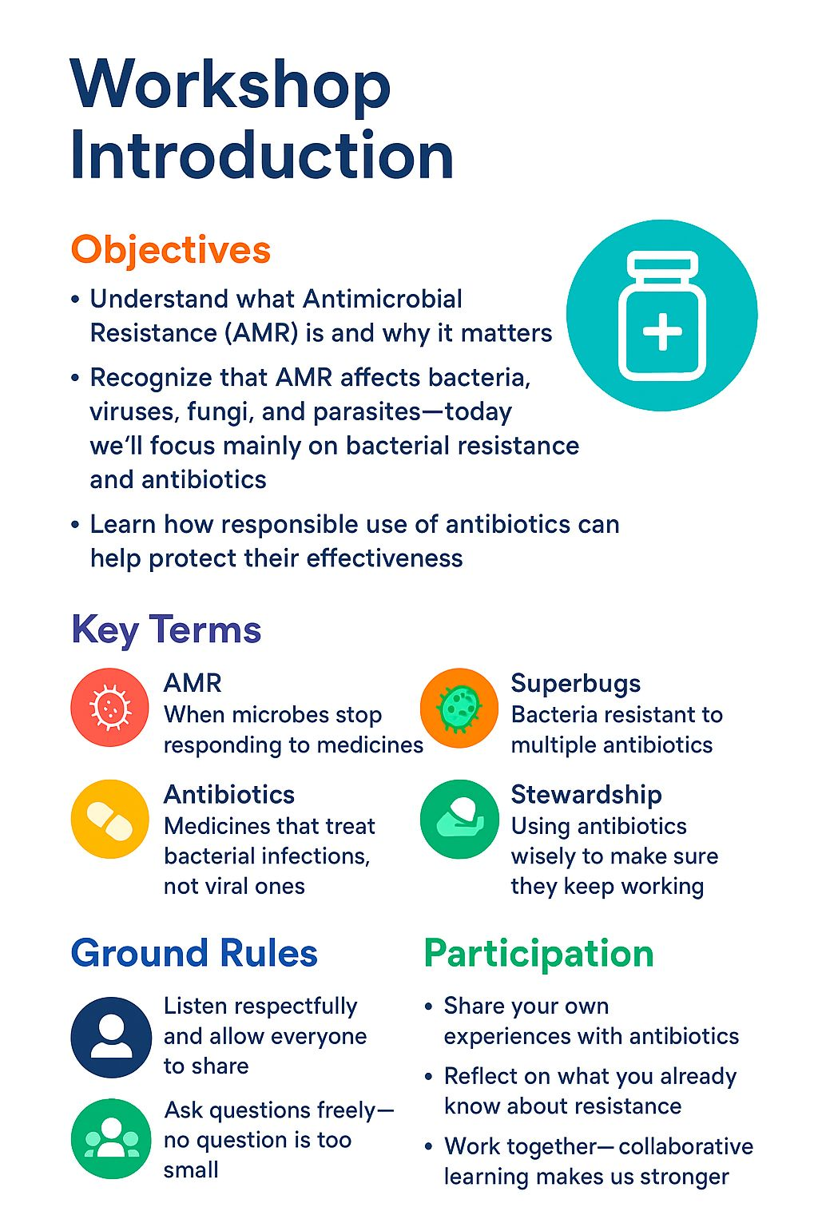
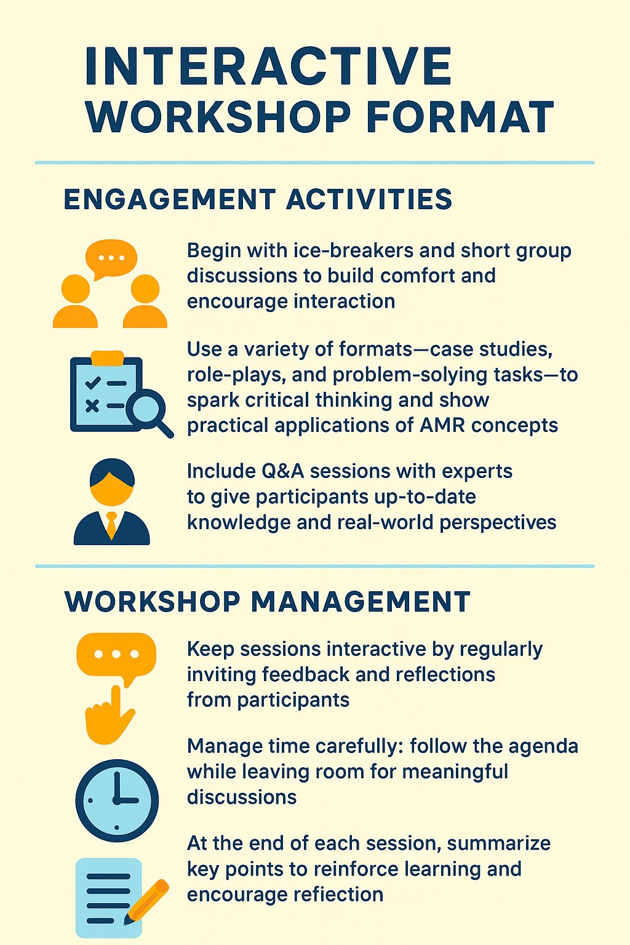
Notes:
Facilitator Notes: The workshop introduction on the left provides context and sets the stage for participants. The notes on the right are intended for organisers, offering key tips and guidance to help run an engaging and successful workshop.

Slide 6
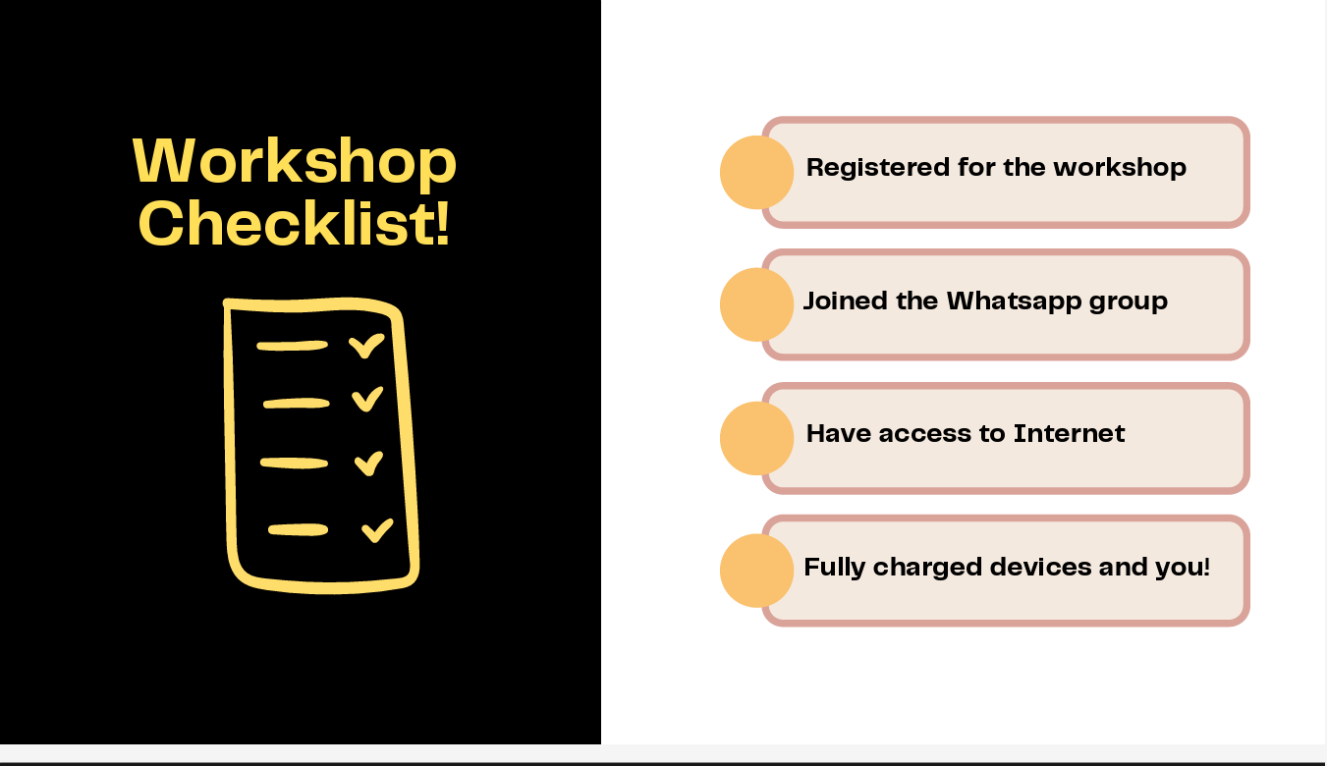
Notes:
Facilitator Notes: Many of our activities require internet access and an electronic device. We encourage students to bring these with them to the workshop.

Slide 7

Pre-Workshop Questionnaire
For AMR Frontline Workshop
Scan and Submit
Notes:
Facilitator’s Note: A QR code linking to the Pre-Workshop Questionnaire (hosted on Google Forms) is to be provided on this slide. Ask participants to scan the code and complete the questionnaire before the session begins. This will help you gauge their baseline knowledge and later measure the learning outcomes achieved by the end of the workshop. A sample/draft questionnaire is available on our website for your reference and customization, if needed.

Slide 8
7
5
AMR EDITION
BREAK THE
TABOO
Notes:
Facilitator's Note: 'AMR Taboo' is a great way to break the ice with the participants and gauge their interest levels and knowledge of key concepts related to AMR. See the AMR Taboo activity document for detailed instructions.

Slide 9
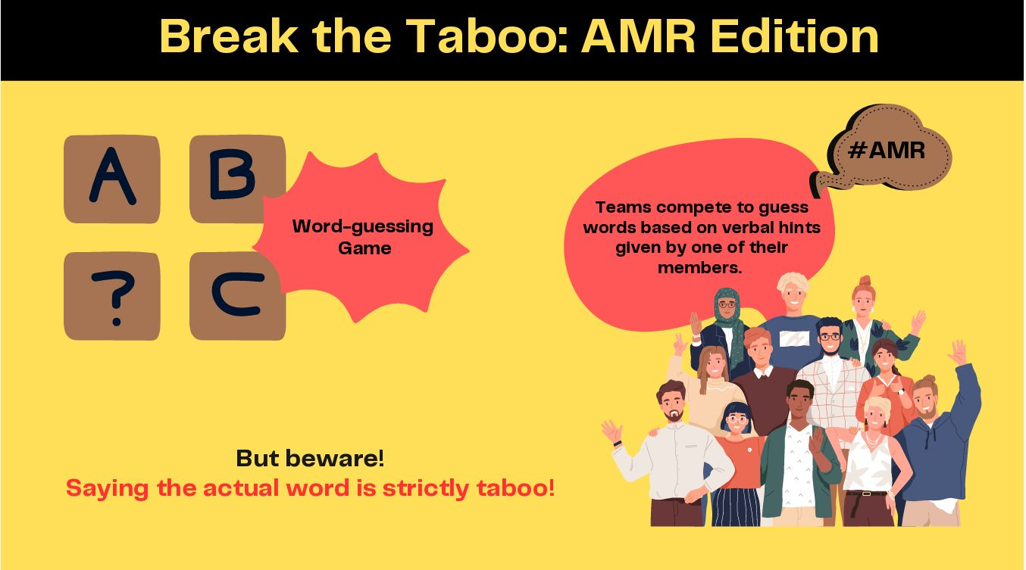

Slide 10
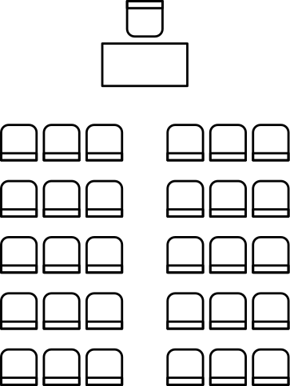

Let’s Play TABOO!
  Each group nominates one member as a hint-giver for Round 1. The hint-giver from the first group comes forward and draws an AMR-related cue card.
  The hint-giver provides verbal descriptions to help the team guess the word within 15 seconds. Saying the word, its exact meaning in hindi, gestures, sounds, or rhyming hints is strictly TABOO!
  If the team guesses the correct word within the given time frame, they get a balloon which represents 10 points. If they fail to do so, they get zero points and the game proceeds with the next group.
  The game proceeds for three rounds and the team with the maximum number of balloons wins.
Group 1
Group 3
Group 2
Group 4

Slide 11
What is AMR?
  AMR occurs when disease-causing microorganisms like bacteria, viruses, fungi, and parasites develop resistance to the drugs that were once effective against them, thus making the infections harder to treat.
  Antimicrobial-resistant infections are on the rise due to the irresponsible human use and disposal of antimicrobials such as antibiotics, as well as a lack of new drugs to fight drug-resistant strains.
  AMR or drug-resistant infections know no boundaries. Everyone is affected, everyone needs to act!
Notes:
Facilitator’s Note: Begin the workshop by outlining the learning objectives and introducing the topic. The following slides provide a primer on AMR, its definition, causes, and impact. This section can either be delivered by the workshop facilitator as a basic introduction or serve as part of the first expert talk.

Slide 12

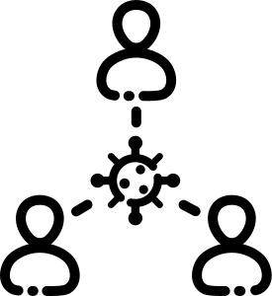



...and why you should care?
Global Threat
causing 700,000 deaths annually worldwide
The Silent Pandemic
projected to cause
2 million deaths in India by 2050
Economic burden
could cost the global economy USD 100 trillion by 2050
Compromised health
limits treatments & undermines medical advances and worsens health inequities
Notes:
Facilitator’s Note: Ensure you use the latest data on AMR for this slide. Use this to provide a high-level picture of the AMR crisis and why it is important to act NOW!

Slide 13
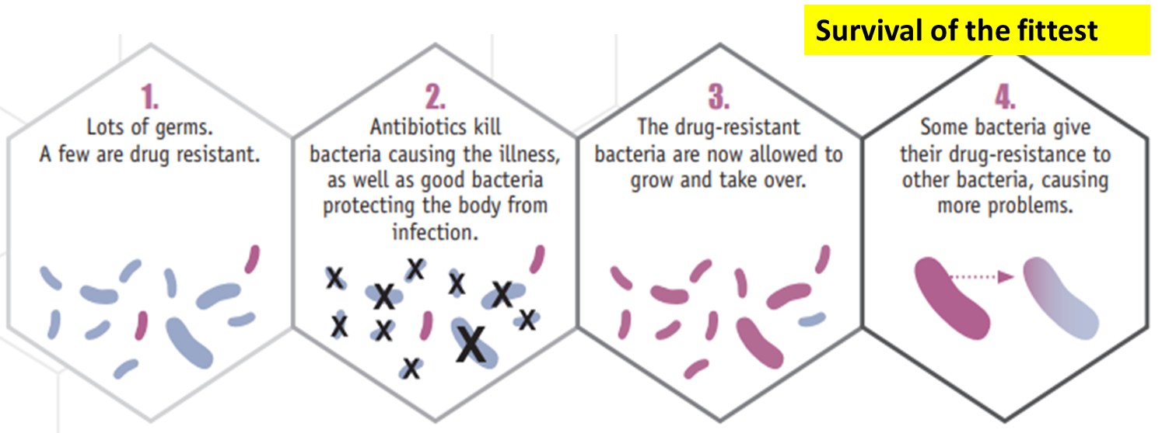
AMR is an evolutionary phenomenon...
Source: CDC
Notes:
Facilitator’s Note: AMR = natural evolutionary process (“survival of the fittest”). Some bacteria are naturally resistant; antibiotics kill others, leaving resistant strains to multiply and share resistance genes. Human actions (overuse, incomplete doses, misuse) accelerate this process. Emphasize: resistance is natural, but good stewardship and responsible use of antibiotics can slow its spread and protect their effectiveness.

Slide 14

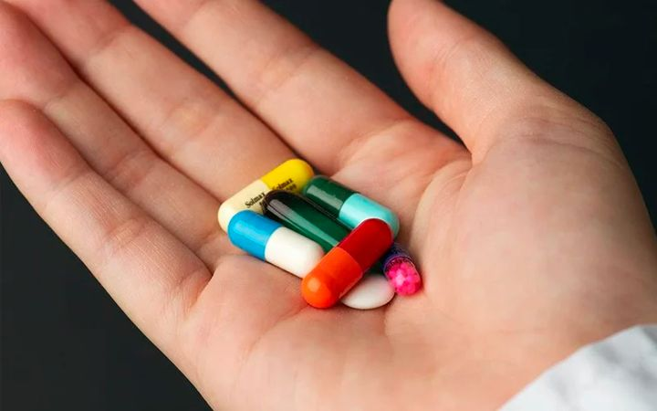

Leading Cause of AMR in India
Over prescription
Self medication
Regulatory gaps
Notes:
Facilitator’s Note: Continue the discussion from the previous slide about the leading cause of concern for the rise in AMR in India, How each of these factors contribute significantly to AMR burden.

Slide 15
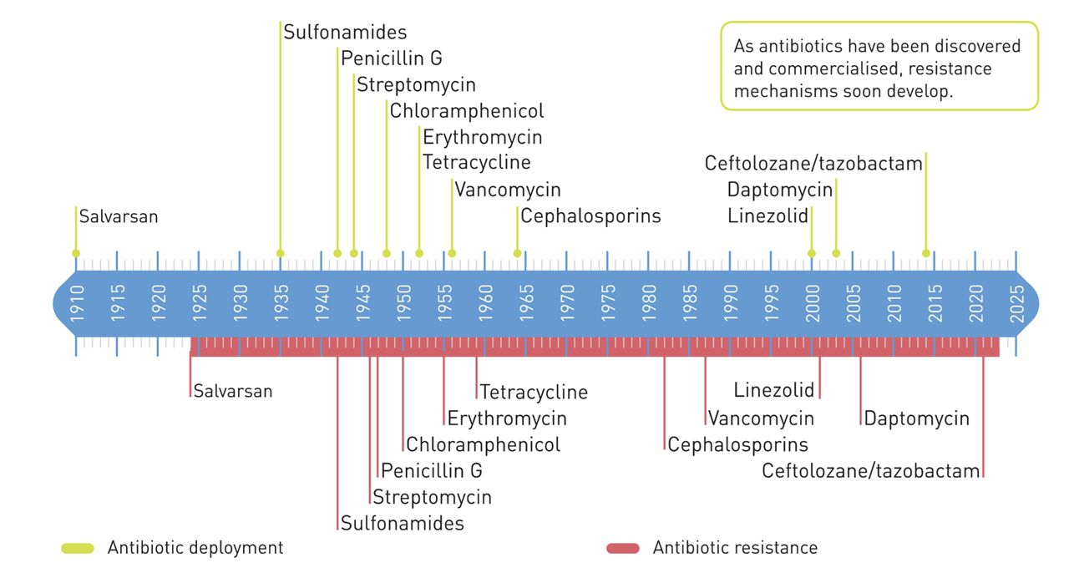
Commercial deployment of antibiotics and emergence of antibiotic resistance
– A timeline
Source: https://www.unep.org/resources/superbugs/environmental-action
Notes:
Facilitators’ note: This slide presents a timeline of antibiotic development and AMR from the pre-antibiotic era to the current crisis. It highlights key events in antibiotic discovery, widespread use, and the rise of drug-resistant infections. It is important to highlight how quickly resistance develops.

Slide 16



Where are we using these antibiotics?
In Healthcare
To treat bacterial infections and as a prophylaxis measure.
Over Prescribing
Over-the-counter sale
Self Medication
Incomplete/Over dosage
In Agriculture
Routine use of antibiotics (e.g., streptomycin) as fungicides in crops to prevent diseases.
Antibiotic residues in environment.
In Animal Farming
Routine antibiotic use for growth promotion, disease prevention.
Use of critically important antibiotics (CIA) for humans.
Notes:
Facilitators’ note: This slide presents the different sectors that use antibiotics, contributing immensely to increase in Multi-Drug Resistance Infections. Discuss about each of these sectors and why it is important to use antibiotics judiciously.

Slide 17
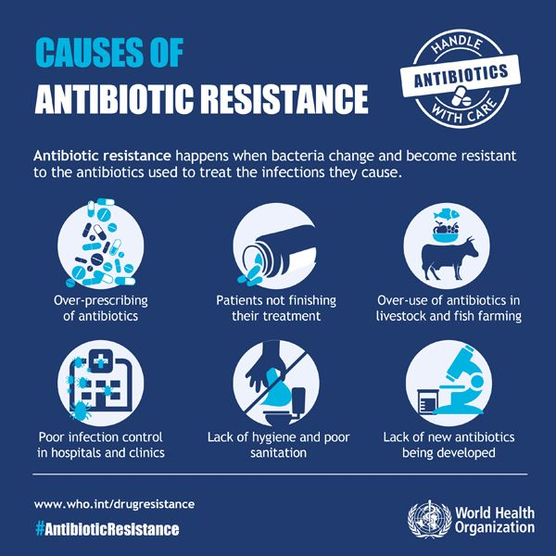
Use,
Misuse, Overuse
of antibiotics
Notes:
Facilitators’ note: Continue the discussion from the previous slide highlighting WHO’s warning towards use, misuse and overuse of antibiotics in everyday life

Slide 18
HOW DO WE TACKLE AMR?
  Policy and Regulation: India’s national policies reflect WHO guidelines, yet enforcing these, especially in rural areas, is challenging.
  Education and Awareness: Essential targeted programs are needed for areas prone to self-medication, aligning with WHO’s guidelines.
  Hospital Infection Control: WHO-recommended practices are being adopted in Indian hospitals, but widespread application remains a challenge.
  Surveillance and Research: Comprehensive surveillance is vital for policy, as supported by WHO and ICMR.
  Antibiotic Stewardship: Endorsed by the FDA and WHO, stewardship programs need wider implementation and government backing in India.
Clinicians, Researchers and Scientists can help with solutions to each of these issues that will be addressed during the course of this workshop
Notes:
Facilitators’ note: This slide highlights the key steps for addressing AMR on a global scale. The workshop covers all or some of these topics to provide participants with a comprehensive understanding of the causes, consequences, and solutions to AMR, emphasizing their individual roles as future doctors.

Slide 19
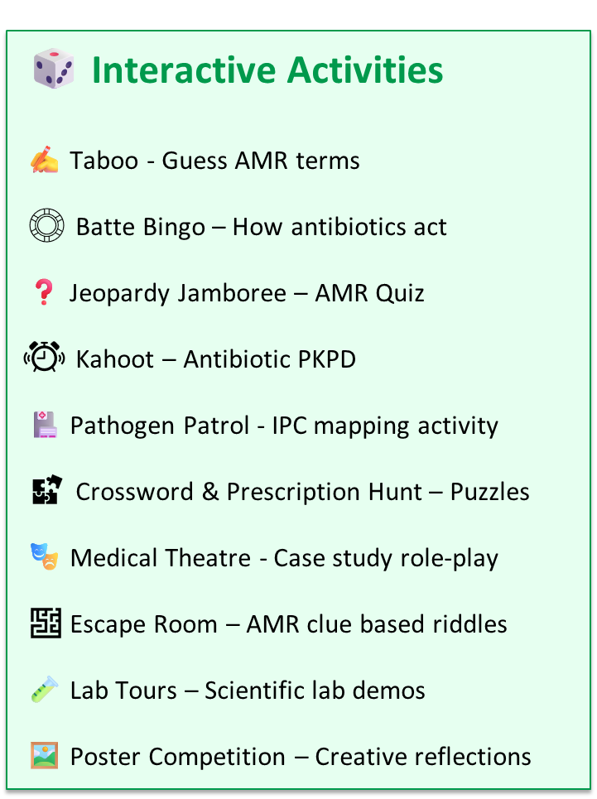
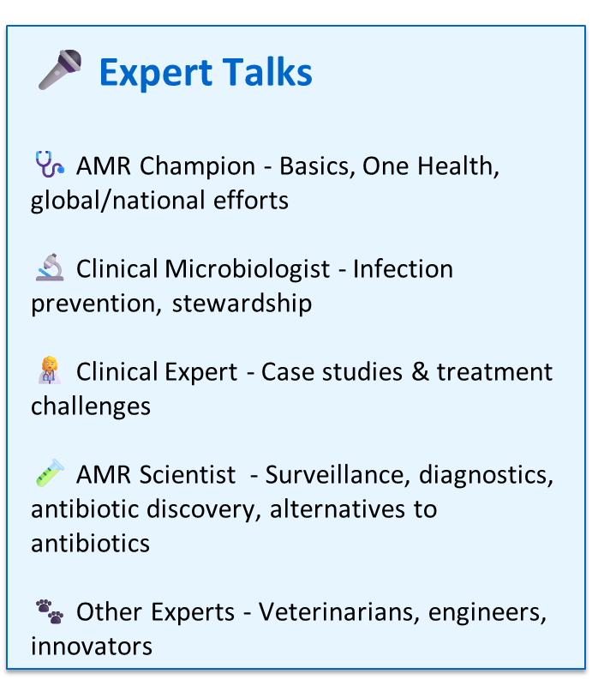
List of Talks and activities
Notes:
Facilitator Notes: This is a full list of expert talks and interactive activities we have used in our workshops. Use it as a guide to design your own workshop, adapting or swapping elements based on time, audience, and goals.We usually intersperse activities throughout the day, ensuring at least one activity between talks so participants don’t sit through two talks in a row. Talks on related topics are often grouped together and paired with relevant activities. For example: a) A stewardship talk may be combined with an IPC activity, bingo, or Kahoot. b) A clinician’s talk can be paired with case studies. Experts are requested to support the activity immediately following their talk, offering guidance aligned with their area of expertise. Each workshop also includes one major, time-intensive activity, such as a medical theatre, lab tour, escape room or poster competition. We typically close with either a Jeopardy Jamboree or a poster competition - the quiz serves as a fun roundup of everything learned during the day, while the poster competition encourages participants to reflect on and consolidate their key takeaways.

Slide 20
Keynote Lecture
Science of AMR and Surveillance Efforts
AMR - Introduction
AMR Surveillance
Importance in early detection and prevention of disease outbreaks
Photo
Name and Designation
Notes:
Facilitators’ note: Introductory slide for the speaker, the sessions and the topics that will be discussed

Slide 21
Expert Lecture
Safe zones and Watchful Eyes:
Antimicrobial Stewardship and Antibiotic Policy
  Antibiotic Policy and Stewardship
  Role of clinicians in reducing antibiotic use.
  Good prescription practices
  AWARE classification
Photo
Name and Designation
Notes:
Facilitators’ note: Introductory slide for the speaker, the sessions and the topics that will be discussed

Slide 22
Interactive Lecture
Clinical Battlefront: AMR challenges in Clinical Settings through case studies
Photo
Challenges faced by Clinicians while treating patients with drug-resistant infections.
Name and Designation
Notes:
Facilitators’ note: Introductory slide for the speaker, the sessions and the topics that will be discussed

Slide 23
Guest Lecture
AMRpreneurs: Developing Diagnostic Tools for AMR/ Drug Discovery
Photo
Development of Diagnostics tool kits, new antibiotics or alternatives to antibiotics or surveillance strategies to combat disease outbreaks.
Name and Designation
Notes:
Facilitators’ note: Introductory slide for the speaker, the sessions and the topics that will be discussed

Slide 24

Notes:
Facilitator Notes: The crossword and prescription-hunt word puzzle (displayed as a large poster in the workshop room or near the refreshment area) are designed as light, fun activities for students to engage with during tea/coffee breaks.

Slide 25


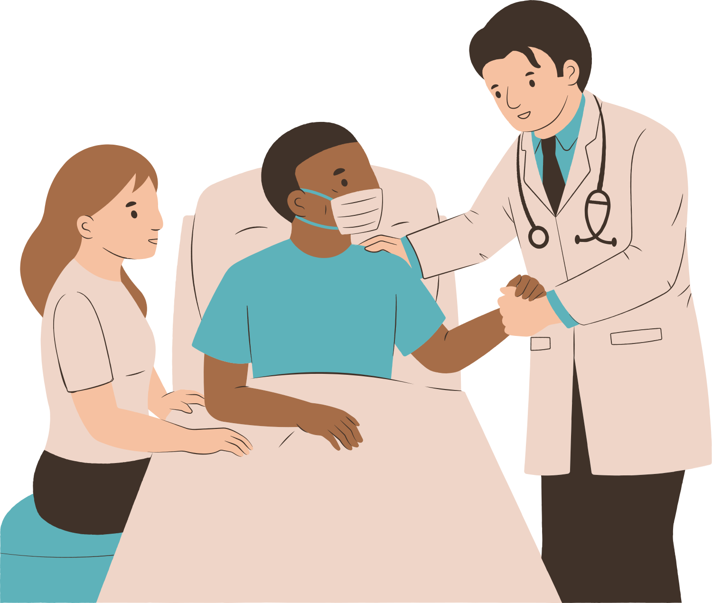
Code Red - The Prescription Challenge
Notes:
Facilitator's Note: Code - Red Prescription challenge is a great way to engage the participants in a meaningful analysis of different case scenarios from real life examples. This activity helps them understand the complexities and nuances involved in prescribing antibiotics and also practice writing a good prescription. See the Code- Red document for detailed instructions.

Slide 26

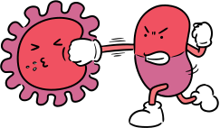
AMR Battle Bingo
Notes:
Facilitator's Note: AMR Battle BINGO allows the participants to test their knowledge and understanding of different antibiotic classes and their mode of action. See the AMR Battle Bingo document for detailed instructions.

Slide 27

Lets play KAHOOT
DIVIDED INTO TEAM and EACH TEAM LOGIN WITH THE GAME PIN at www.kahoot.it
Notes:
Facilitator's Note: Kahoot is an online quiz platform and a great way to engage the participants in a fun quiz competition on the pharmacokinetics and pharmacodynamics of antibiotics. Check the Kahoot AMR edition document for detailed instructions.

Slide 28



The Resistance Riddle:
Breaking the AMR Code
Notes:
Facilitator's Note: The Escape Room is an engaging and interactive way to help participants explore and analyse different concepts related to AMR by solving puzzles. Refer to the Escape Room instruction sheet for detailed guidance on setup and facilitation.

Slide 29
The year is 2025, and a mysterious outbreak of antimicrobial-resistant infections has struck St. Germs General Hospital. ICU patients are succumbing to infections, the pathogen spread is uncontrolled, and panic is mounting. You are a team of infectious disease experts tasked with unraveling the mystery, containing the outbreak, and developing a plan to stop the rise of AMR.

Slide 30

Notes:
Facilitator Notes: Medical Theater - One of the case studies can be transformed into a live role-play, where facilitators act out scenarios and students step into the role of the doctor to solve the case. This format brings to life different situations of misuse and overuse, making the learning experience more engaging and memorable.

Slide 31
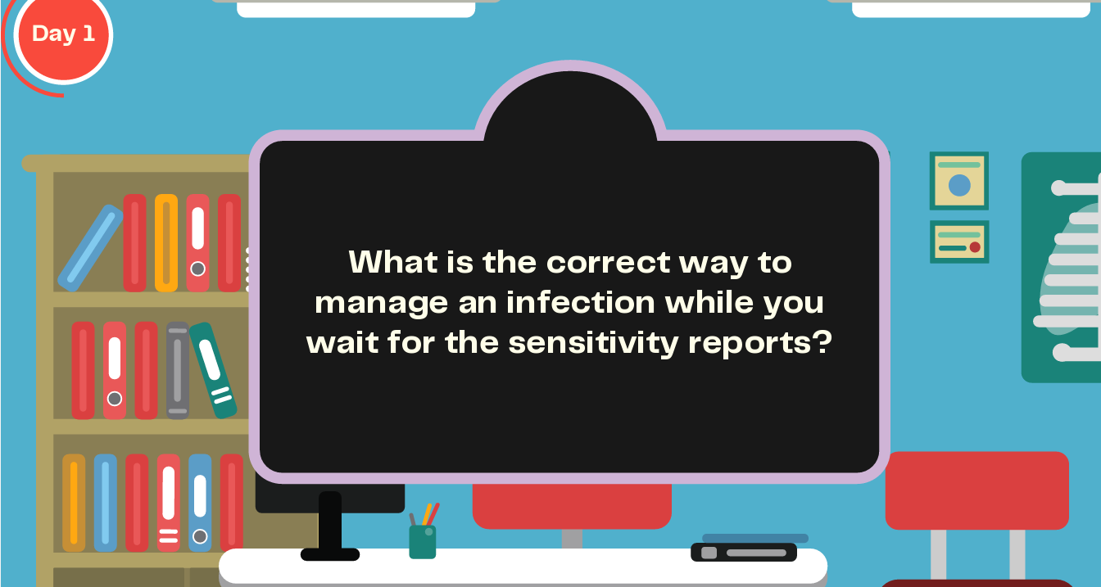
Notes:
Facilitator Notes: This is a sample question that can be asked during the live case to encourage participants to think critically about the appropriate course of action. This is drawn from one of our previous workshop theatre sessions.

Slide 32
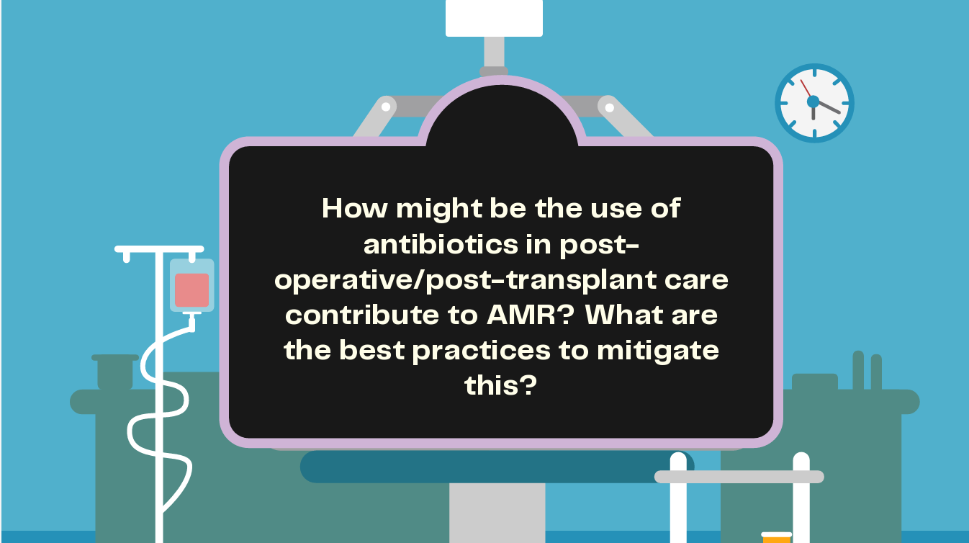
Notes:
Facilitator Notes: Examples of questions that can be asked during the live case to prompt participants to think about the right course of action. This is taken from one of our workshops where a scenario based on a post-surgical AMR infection was discussed using medical theater.

Slide 33

Jeopardy Jamboree: Fast paced Quiz
Round 1:
Individual
Top 20 scorers
Round 2:
Jeopardy style Quiz
4 teams
(5 members in each)
Winning
Team
Notes:
Facilitator's note: This is a fun and competitive group quiz based on the key themes covered during the workshop. To ensure everyone gets a chance to participate, the quiz is conducted in two stages. In the first stage, all participants take part. The top-performing teams from this round move on to the second stage, where they compete in the main quiz for the win! Refer to the Jeopardy quiz and ppt document available on the Superheroes Against Superbugs website (https://sasuperbugs.org/) on the 'Medical Students Webpage’. Please follow the instructions to run the quiz.

Slide 34
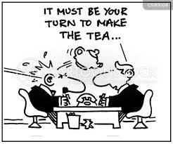

Notes:
Facilitator Notes: The Qualifiers for round 2 group quiz are determined from the round 1 quiz on the principle of fastest fingers first (the ones with maximum correct answers in the shortest possible time). Because this takes a little time, we include a short break between rounds. The crossword and prescription-hunt word puzzle (displayed as a large poster in the workshop room or near the refreshment area) are designed as light, fun activities for students to engage with during breaks.

Slide 35

Round 2: Guidelines
Team Competition
  Teams will compete in an interactive Jeopardy-style quiz session.
  Each team will have the opportunity to answer questions.
  If a team is unable to answer within the given time frame, the question will be passed onto the next team.
  There will be 4 themes related to AMR.
  Each theme will have 4 different score categories: 100, 200, 300, and 400 points.
  Teams will select a theme and corresponding score category for each question.
  Questions will appear on the screen.
  Teams will have 30 seconds to provide their answer.
  If the answer is incorrect, the team will receive 0 points.
Theme & Score Categories
Question Format & Timing

Slide 36
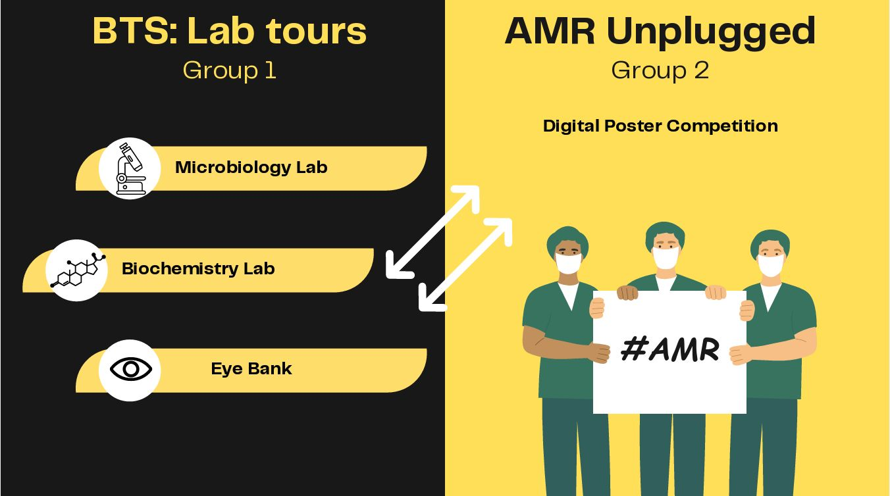
Notes:
Facilitator Notes: Where facilities permit (e.g., when the workshop is hosted at a research institute), participants can be divided into two groups. One group can go on lab tours - such as a microbiology lab for diagnostics, a biochemistry lab developing antibiotic alternatives, an antibiotic discovery lab, or even a tissue bank with stringent infection control practices - while the other group works on the poster competition (refer to the next slide).

Slide 37
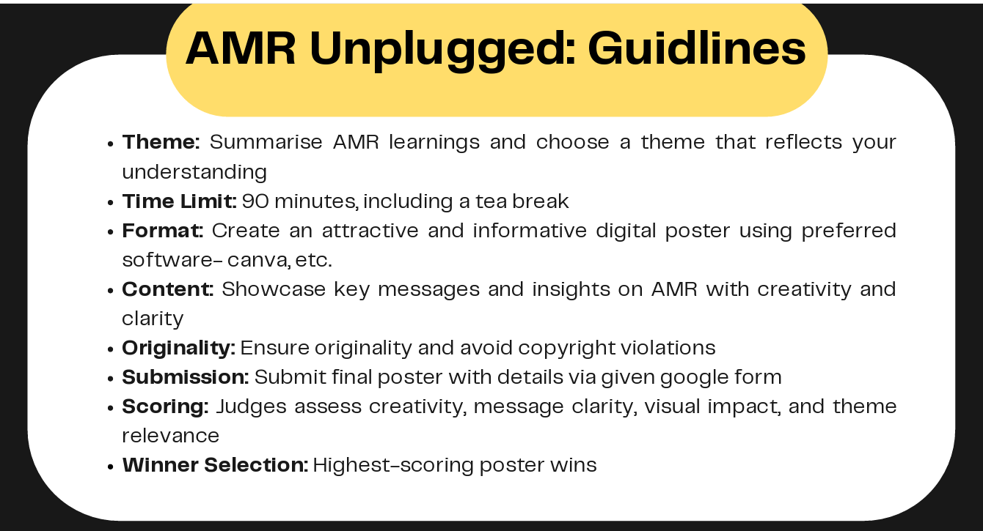
Notes:
Facilitator Notes: Instructions for the poster competition

Slide 38
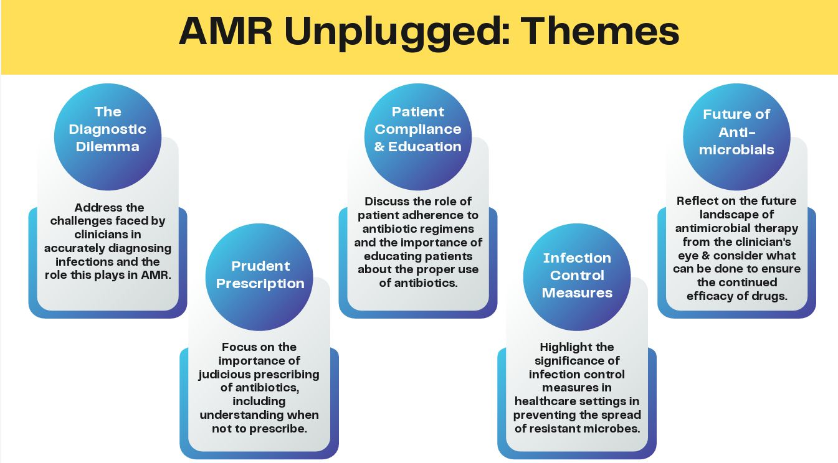
Notes:
Facilitator Notes: Some themes that were used in our competitions

Slide 39
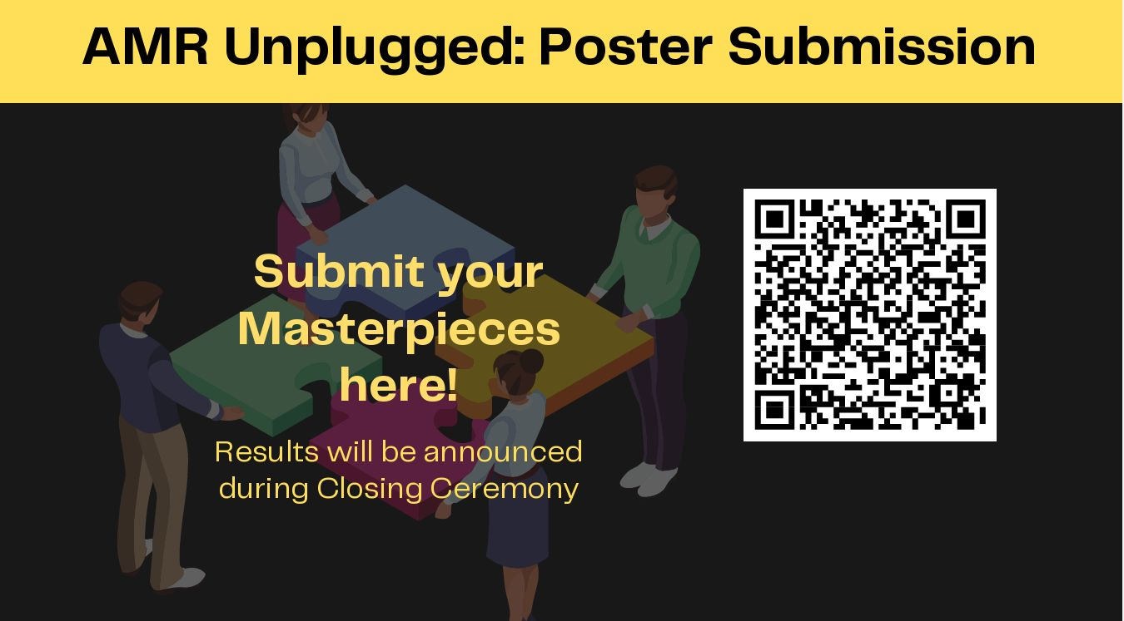
Notes:
Facilitator Notes: A similar QR code for a google folder can be created for participants to submit their digital posters, either individually or in groups. Expert speakers and/or faculty at the medical college can then review and judge the best entries.

Slide 40



Here’s what we learnt today....
AMR is a global health threat. It affects everyone and everyone has a role to play in tackling this health issue.
Your role as future doctors: Be responsible prescribers and educators, ensuring the rational use of antibiotics.
Key actions to combat AMR:
Promote infection prevention and hygiene practices.
Educate patients on the correct use of antibiotics.
Support antimicrobial stewardship programs.
Looking ahead: Innovate and contribute to raising awareness, research in diagnostics, vaccines, and alternative therapies to combat AMR.
Notes:
Facilitators' Notes: Conclude the workshop by briefly summarizing the key themes covered to reinforce learning and aid retention. This quick recap helps participants consolidate their understanding and reflect on the main takeaways.

Slide 41
Educational Resources
WHO Course:
  Antimicrobial Resistance: https://openwho.org/channels/amr
  Infection Prevention and Control: https://openwho.org/channels/ipc
  Antimicrobial Stewardship: https://openwho.org/courses/AMR-competency
Coursera Course:
  Antimicrobial Resistance: https://www.coursera.org/learn/antimicrobial-resistance
CDC Course:
  Antibiotic Stewardship: https://www.train.org/cdctrain/training_plan/3697

Slide 42
Educational Resources
Stanford Online
  Antibiotics Review: http://errolozdalga.com/medicine/pages/OtherPages/AntibioticReview.ChanuRhee.html
  Antibiotics and Outpatient Infections (CME): https://online.stanford.edu/courses/som-ycme0020-prescribe-or-not-prescribe-antibiotics-and-outpatient-infections-cme
  Fleming Fund Online AMR Course
  Diagnostic Stewardship: https://www.open.edu/openlearncreate/course/view.php?id=6559
  AMR Surveillance: https://www.open.edu/openlearncreate/course/view.php?id=6548

Slide 43

Post-Workshop Feedback
Notes:
Facilitator’s Note: Share the QR code linked to the post-workshop feedback form with participants. Encourage them to scan and complete it, as their inputs are valuable for improving future workshops. It is important to evaluate the workshop itself and the form repeats some questions from the pre-workshop survey to help evaluate learning outcomes and track improvements. A sample/draft questionnaire is available on our website for your reference and customization, if needed.

Slide 44
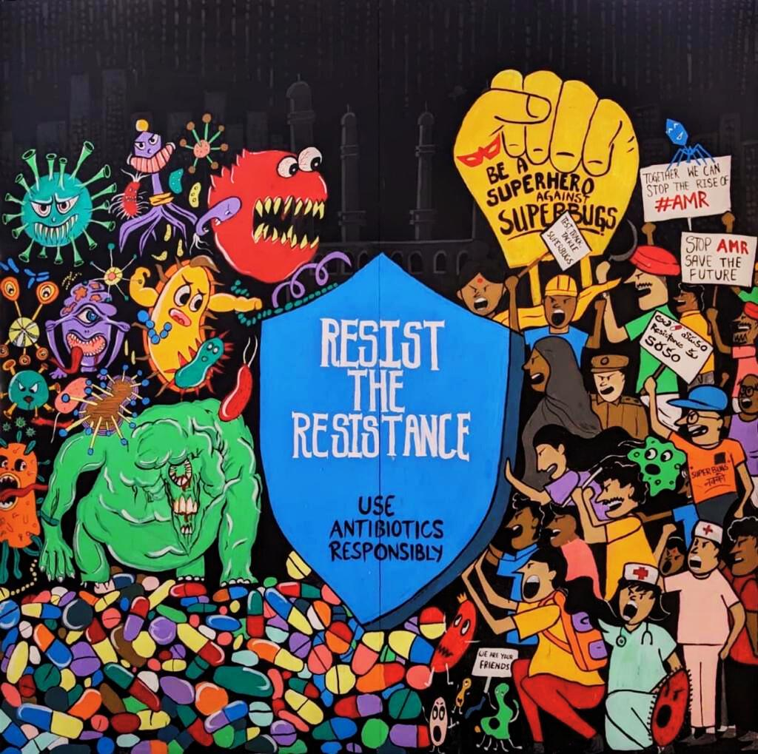
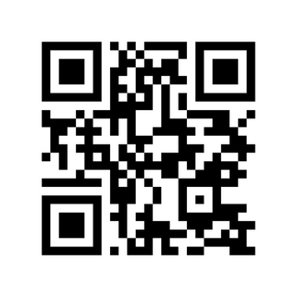
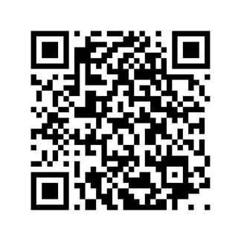
Unite with the Superheroes in the fight against Superbugs!
Scan to visit our website
Scan for our IG page
Notes:
Facilitators' Notes: Refer to SaS website to download a list of reading and learning resources that can be shared with the students.

